Slide 1
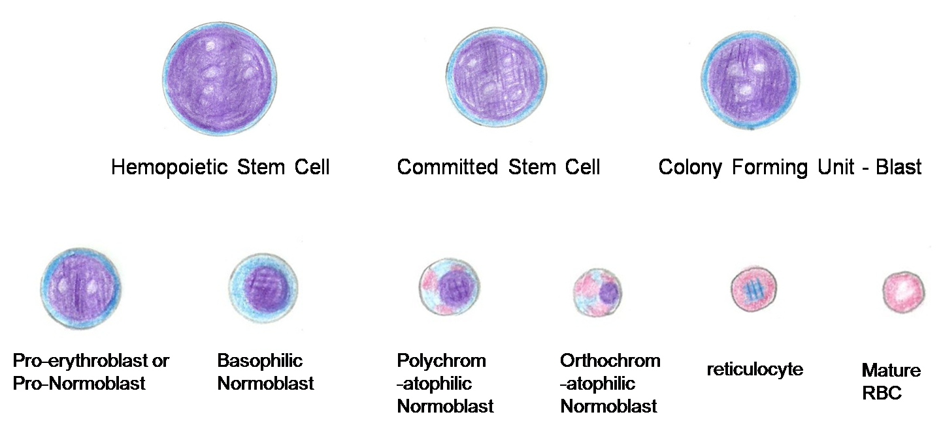
Erythropoiesis
Sunita Mittal

Slide 2
Learning Objectives
Stem cells
Process of erythropoiesis - site, stages
Factors affecting erythropoiesis

Slide 3
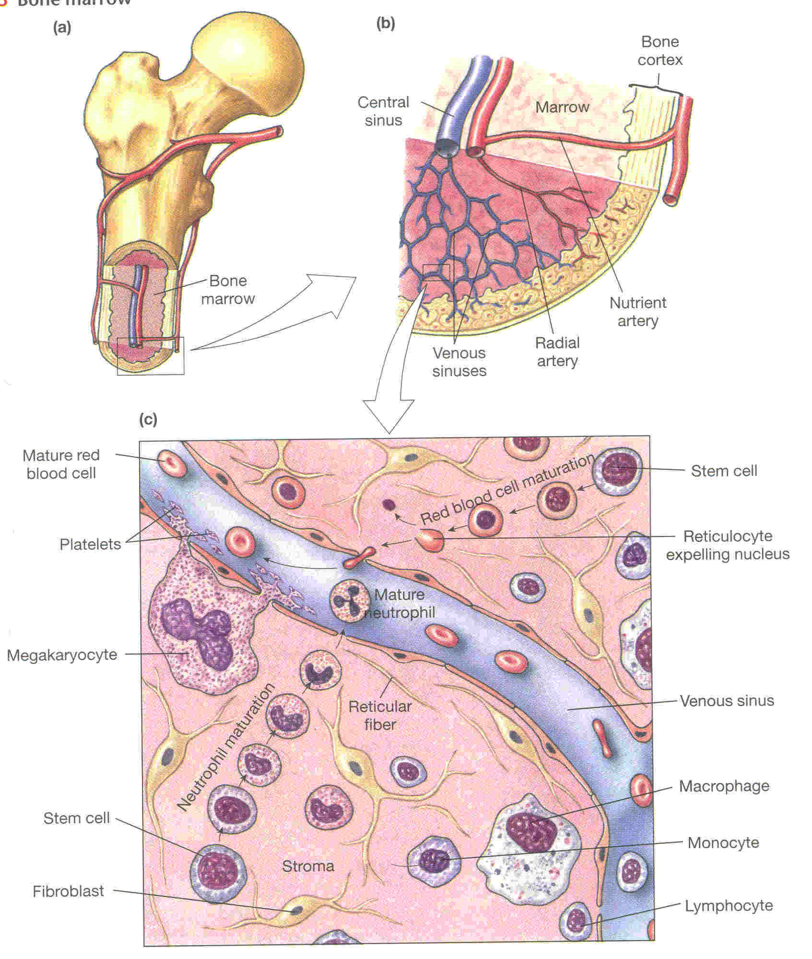
Hematopoiesis
The process of formation of new blood cells

Slide 4
Lineage Cells of Hematopoiesis- HSCs
▫ Blood (Hemopoietic) Stem Cells are divided into:
1. Myeloid stem cells or
2. Lymphoid stem cells
In bone marrow
Hemopoietic Stem Cells

Slide 5
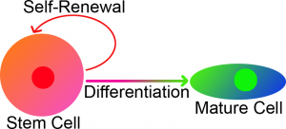
Stem Cells
Stem cells : Cells that are able to
1) Self-renew to form ‘parent pool’ (can create more stem cells indefinitely)
2) Differentiate into (become) specialized, mature cell types.

Slide 6
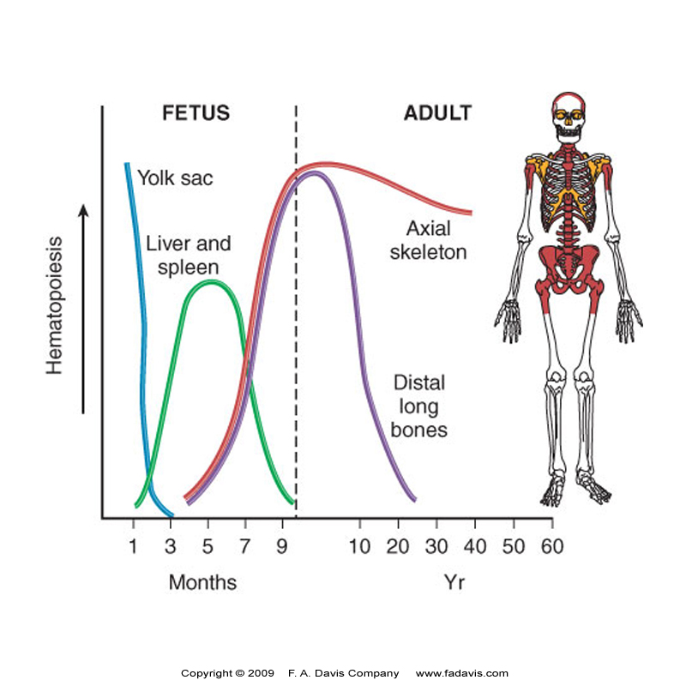
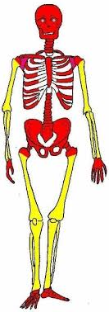
Site of Hematopoiesis
After birth | During fetal life
Active (red) BM: In infancy & childhood In adult | 1) Yolk sac: 2) Liver & Spleen: 3) Bone marrow (BM):

Slide 7
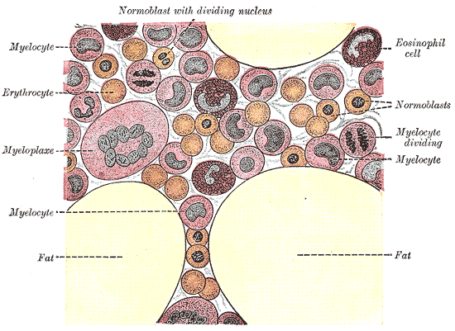
Characteristics of Bone Marrow
One of the largest organs in body.
10¹¹-10¹² Cells are daily formed to be taken to the periphery through blood vessels

Slide 8
Steps of Erythropoiesis
Lymphoid Stem Cells
COMMITTED STEM CELLS or Progenitor cells
HSC
Colony Forming Unit-Blast (CFU-B)→ Colony Forming Unit-Erythroblast
(CFU-E)
Myeloid Stem Cells
Colony Forming Unit – Spleen (CFU-S) → CFU GM
→ CFU M
▪ MSC ▪ CFU-B ▪ CFU-E
Pronormoblast
Basophilic normoblast
Polychromatophilic Normoblast
Orthrochromatophilic Normoblast
Reticulocyte
Mature Red Blood Cell

Slide 9
Stages of Erythropoiesis
Pronormoblast (Proerythroblast)

Slide 10
Stages of Erythropoiesis
Early Normoblast (basophilic normoblast)

Slide 11
Stages of Erythropoiesis
Intermediate normoblast (polychromatic normoblast)

Slide 12
Stages of Erythropoiesis
Late Normoblast (Orthochromatic Normoblast)

Slide 13
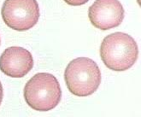
Stages of Erythropoiesis
Reticulocyte
Mature RBC

Slide 14
Factors regulating Erythropoiesis
Φ Growth or Developmental Factors
Φ Nutritional Factors
Φ Hormonal Factors
Φ Healthy Liver and Bone marrow

Slide 15
Self Assessment
1) After birth all blood cells except ………………………. are formed in bone marrow.
2) In adults hemopoietic bone marrow is confined to axial skeleton and ………………….of humerus & femur.
3) Interleukins …………………………………..to convert PHSC to Committed Progenitor cells.
4) ……………………………can be stimulated to form any cell in the body.
5) Hemoglobin first appears in ……………………………….stage of Erythropoiesis.
6) In early normoblast stage of Erythropoiesis, cell cytoplasm is stained by ………………… dye.
7) Erythropoietin is secreted from ……………………….of kidney.
8) ………………………….are important in the maturation of the RBCs.
9) RBCs do not contain a nucleus, endoplasmic reticulum and …………………….
10) 1 gm of hemoglobin contains………………………….iron.

Slide 16
Thank you

