Slide 1
Paediatric Retinal Diseases
Dr Sanjeev K. Mittal MS, FICO
Prof & Head, Ophthalmology
AIIMS, Rishikesh

Slide 2
Symptoms of Retinal Diseases
Diminution of vision without pain
Night blindness
Photopsia- sparks or lightening flashes
Metamorphopsia- distorted images
micropsia & macropsia
Peripheral constriction of visual field
Patient unaware of symptoms

Slide 3
Symptoms of Retinal Diseases in Paediatric cases
Diminution of vision without pain
Night blindness
Photopsia- sparks or lightening flashes
Metamorphopsia- distorted images
micropsia & macropsia
Peripheral constriction of visual field
Patient unaware of symptoms
Jerky movements of eyes[Nystagmus]

Slide 4
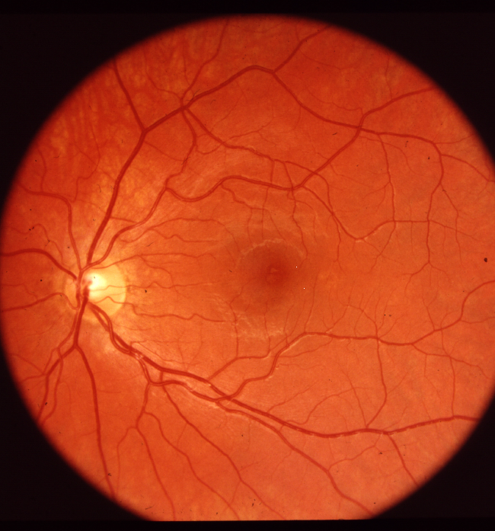
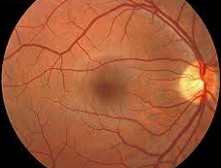
Normal Fundus

Slide 5
What do we examine in fundus?
Fundal glow/ ocular media
Optic disc
Retinal blood vessels
General (Background) fundus
Macula & foveal reflex
Peripheral fundus

Slide 6
Examination of Fundus (Ophthalmocopy)
Distant direct ophthalmoscopy
Direct ophthalmoscopy
Indirect ophthalmoscopy
Slit lamp assisted Fundus examination-
i] Hruby lens
ii] +90 D / +78 d lens
iii] 3-mirror contact lens

Slide 7
Types of Retinal diseases in Paediatric age group
Retinopathy of Prematurity
Retinitis Pigmentosa
Phakomatosis
Coat’s disease
Hereditary Dystrophies of central retina and choroid
Myelinated nerve fibres

Slide 8
Retinopathy of Prematurity(ROP)
B/L abnormality
Retinal neovascularization
Premature infants
<1500 gm
<32 week gestational age
Given high conc of Oxygen during first 10 days of life

Slide 9
ROP -Signs
Dilatation of retinal vessels
+
hazy white patches in peripheral retina (temporal)
Fibrous tissue
Proliferation & rolling over (Pseudo glioma)
Retinal detachment (Lost vision)

Slide 10
ROP Staging
Stage 1= a faint demarcation line
Stage 2= an elevated ridge
Stage 3= extraretinal fibrovascular tissue
Stage 4= sub-total retinal detachment
Stage 5= total retinal detachment

Slide 11
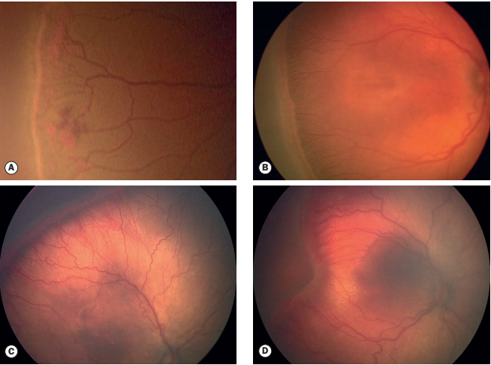
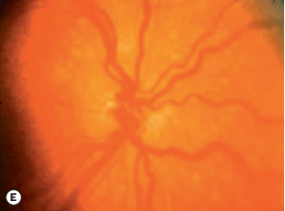
ROP

Slide 12
ROP- Treatment
80% infants spontaneous regression
Treatment required if disease progresses
i] Photocoagulation/ Cryotherapy of avascular, immature retina
ii] Scleral buckling for RD
Prophylaxis is most important

Slide 13
ROP Prophylaxis
Monitor umblical arterial Pa Oxygen level
(50-100 is normal)
Examine temporal periphery of retina before the newborn/infant is discharged from hospital (look for threshold disease)
All premature infants <32 week or <1500 gm should be screened
If ROP develops, follow-up exam

Slide 14
Retinitis Pigmentosa
Hereditary disease
Inheritance-Autosomal recessive
Consanguinity of parents
Progressive night blindness
Constriction of visual field
B/L
Symmetrical , diffuse pigmentary retinal dystrophy which affects Rods
Mostly symptoms appear in young age

Slide 15
Retinitis Pigmentosa
Signs-
Bony specule pigmentation
Arteriolar attenuation
Waxy pallor of disc

Slide 16
Retinitis Pigmentosa
Investigations-
Electro-retinography- amplitude
Electro-oculography- absence of light peak
Visual fields- ring scotoma

Slide 17
Retinitis Pigmentosa-Variants
Atypical RP
Retinitis pigmentosa sine pigmento
Retinitis puntata albescens
Sector retinitis pigmentosa

Slide 18
RP associated with systemic diseases-
Laurence-moon-biedl syndrome(Bardet Biedle)
Bassen-kornzweig syndrome (Abeta lipoproteinemia)
Refsum’s syndrome
Usher’s syndrome
Cockayne’s syndrome
Kearns-Sayre syndrome
Friedreich’s ataxia
NARP syndrome

Slide 19
Persistent Hyperplastic Primary Vitreous
Failure of structures within primary vitreous to regress
Unilateral white pupilary reflex in full term infant
May be Anterior/ Posterior
May be associated with cataract, Glaucoma, Micro ophthalmos, persistent hyaloid artery
Bilateral cases may be associated with Patau’s syndrome or Norries disease.

Slide 20
Coat’s Disease
Chronic, progressive, vascular abnormality
Telangiectic retinal vessels leak fluid
Exudative bullous RD
Boys 18months -18 years
Unilateral
White pupillary reflex
Tt: early photocoagulation
/cryotherapy

Slide 21
Stargardt disease
Recessive, progresstive tapetoretinal dystrophy of central retina
Age 8-14 years
Beaten bronze atrophy of fovea
Extensive chorioretinal atrophy
Poor vision

Slide 22
Hereditary Dystrophies of central retina and choroid
Stargardt disease/ fundus flavimaculatus
Most common macular dystrophy
Gradual impairment of central vision

Slide 23
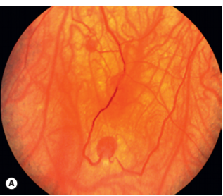
Phakomatosis
(Systemic associations present)
Angiomatosis of retina with cerebellar haemangioblastoma (Von Hippel Lindau disease)
Tuberous sclerosis (Bourneville disease)
Neurofibromatosis (Von Recling hausen disease)

Slide 24
Phakomatosis
Sturge-weber’s syndrome- port wine stain along distribution of trigeminal nerve of affected side

Slide 25
White pupillary reflex (Leukocoria)

Slide 26
Retinoblastoma- dealt in separate lecture

Slide 27
White pupillary reflex (Leukocoria)
Retinoblastoma
ROP
Coats disease
Congenital cataract
Toxocara infestation
Persistant hyperplastic vitreous
Retrolental hyperplasia
Retrolental inflammatory membrane due to Uvitis

Slide 29
MCQs
1] While working in a neonatal ICU your team delivers a premature infant at 27 weeks of gestation and weighing 1500 gm. How soon will you request fundus examination by an ophthalmologist?
(a) Immediately
(b) Three to four weeks after delivery
(c) At 34 weeks’ gestational age
(d) At 40 weeks’ gestational age

Slide 30
MCQs
With which of the following is PHPV associated?
(a) Patau’s Syndrome
(b)Down syndrome
(c) Tuberous sclerosis
(d) Sturge Weber syndrome

Slide 31
MCQs
Amaurotic cat's eye reflex is seen in:
a.Papilloedema
b. Retinoblastoma
c. Papillitis
d. Retinitis

Slide 32
MCQs

Slide 33
MCQs

