Slide 1
Joints of the Foot Dr. Gitanjali Khorwal

Slide 2
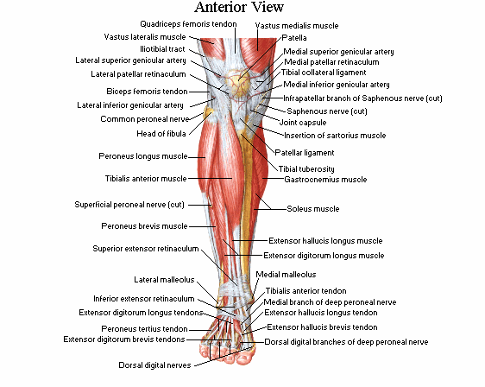
Contents of the anterior compartment
Muscles:
Tibialis anterior
Extensor digitorum longus
Extensor hallucis longus
Peroneus tertius
Anterior tibial artery
Deep peroneal nerve.

Slide 3
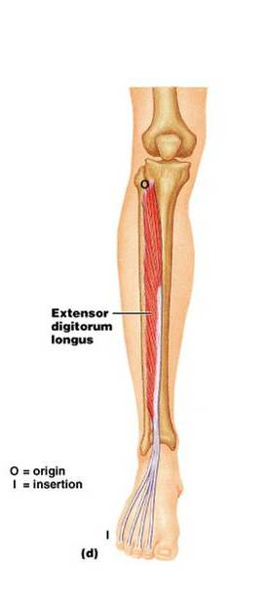
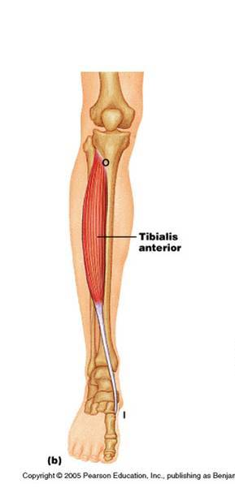
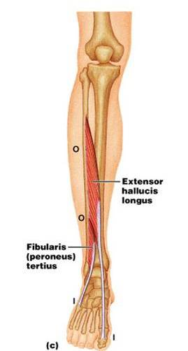
Muscles of the anterior compartment

Slide 4
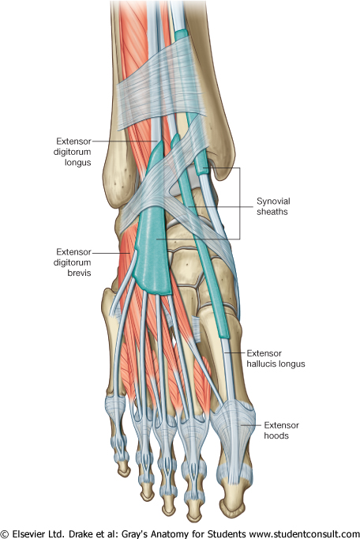
Retinacula
Deep fascia is thickened to form bands.
Retain tendons in place.
Superior Extensor Retinaculum
Inferior Extensor Retinaculum
Superior Peroneal Retinaculum
Inferior Peroneal Retinaculum

Slide 5
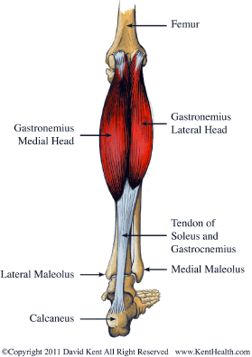
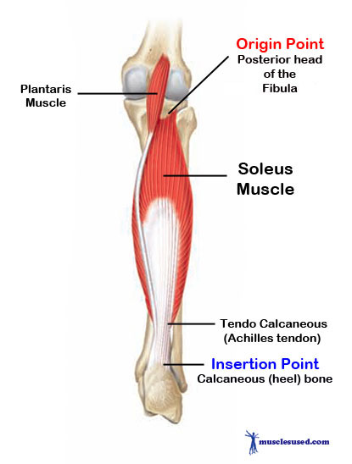
Muscles of the back

Slide 6
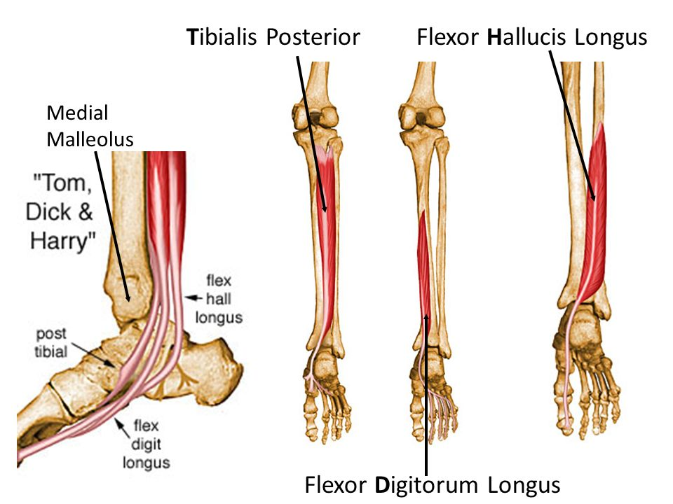

Slide 7
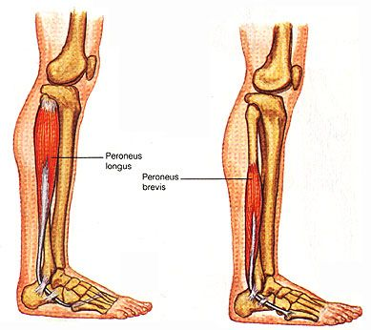
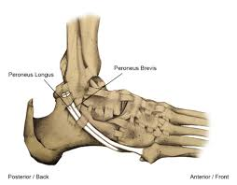
Muscles of lateral side

Slide 8
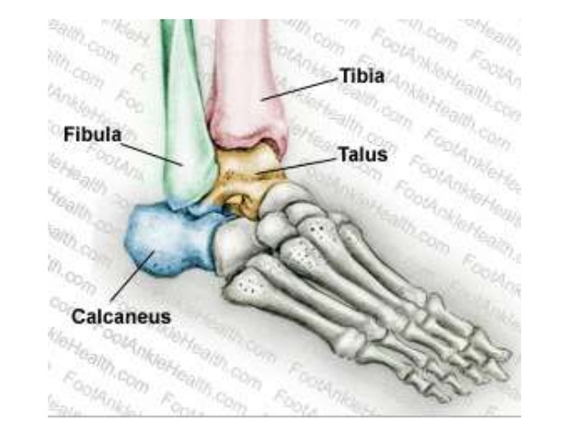
ANKLE or TALO-CRURAL JOINT
Uni-axial synovial joint
Modified hinge joint

Slide 9
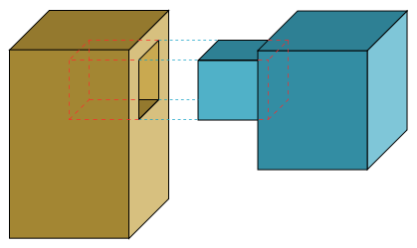
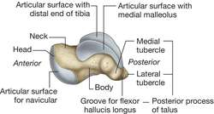
Tibio-fibular mortise

Slide 10
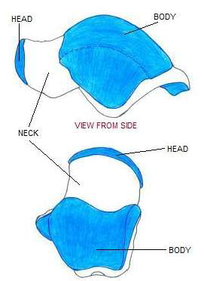
Trochlea tali

Slide 11
Ligaments
Capsule
Synovial membrane
The ankle joint is bound medially by the strong
Deltoid ligament
Three lateral ligaments
•Anterior talofibular ligament
• Posterior talofibular ligament
• Calcaneofibular ligament

Slide 12
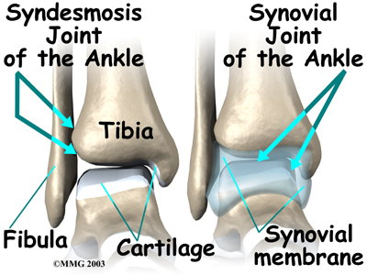

Slide 13
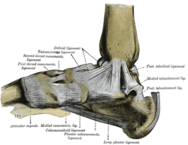
Deltoid ligament or Medial ligament
Superficial part:
Anterior part or Tibio - navicular part
Intermediate part or Tibio - calcanean part
Posterior part or Posterior
tibio - talar part
Deep part/Anterior Tibiotalar

Slide 14
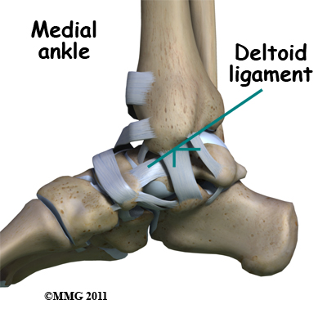

Slide 15
Attachments & parts of deltoid ligament
Medial malleolus of Tibia
Anterior Tibiotalar
Tibiotalar
Talus
Tibionavicular
Sustanticulum Tali
Tibiocalcanean

Slide 16
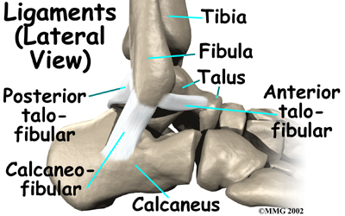

Slide 17
Lateral ligaments
Anterior Talofibular
Lateral malleolus of Fibula
Neck of Talus
Posterior Talofibular
Calcaneofibular ligament crossed by tendons of Peroneus longus & Brevis

Slide 18
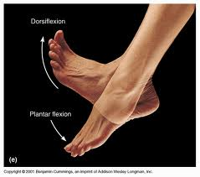
Movements of ankle joint
Dorsiflexion:
Close packed state. Position more stable.
Plantar flexion:
Loosely packed state of joint. Joint is less stable.

Slide 19
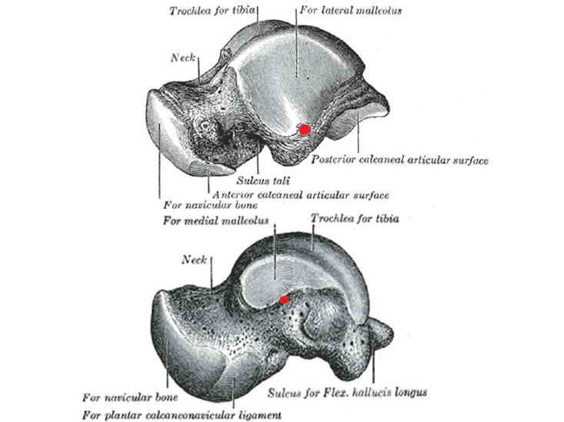

Slide 20
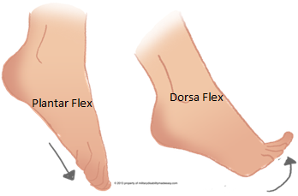
Movements
Plantar Flexion: S1, S2
Gastrocnemius
Soleus
Assisted by
Tibialis posterior,
Flexor Digitorum longus,
Flexor Hallucis longus,
Peroneus longus and brevis in extreme plantar flexion

Slide 21
Dorsiflexion: L4, L5
Tibialis anterior
Extensor Digitorum longus,
Extensor Hallucis longus,
Peroneus tertius

Slide 22
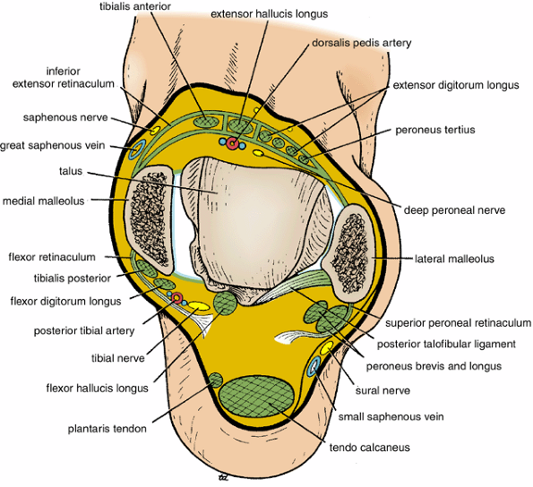

Slide 23
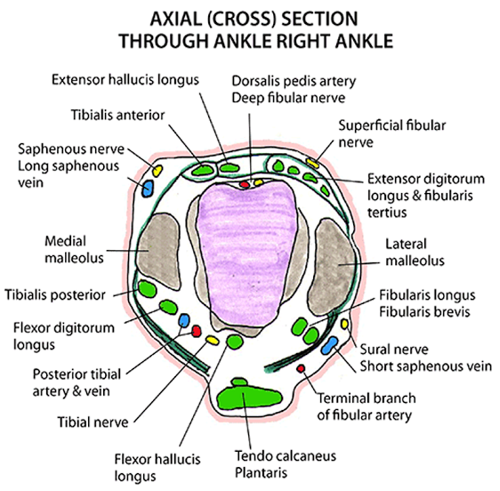

Slide 25
Arterial supply
Malleolar branches of Anterior Tibial Artery.
Malleolar branches of Peroneal Artery.
NERVE SUPPLY
Branches from Deep Peroneal Nerve.
Branches from Tibial Nerve.

Slide 26
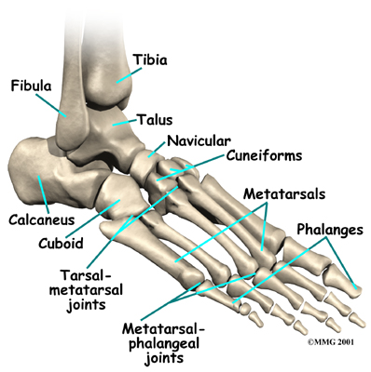
Interphalangeal joints
Typical hinge joint
Permit plantar flexion and dorsiflexion

Slide 27
Metatarso - phalangeal joints
Ellipsoidal type of synovial joint.
Ligaments:
Capsule.
Collateral ligaments.
Deep metatarsal ligaments.
Movements:
Dorsi & plantar flexion.
Adduction & abduction.

Slide 28
Tarso-metatarsal joints
Plane synovial joints
Gliding movements

Slide 29
Intertarsal joints
SIX synovial cavities between tarsus and metatarsus :
Sub-talar
Talo-calcano-navicular Mid-tarsal / Transverse
Calcaneo-cuboid tarsal
d) A joint cavity comprising cuneo-navicular, intercuneiform, cuneo-cuboid and intermediate and lateral cuneiform with bases of 2nd and 3rd metatarsal bone.
e) Between medial cuneiform and base of 1st metarcarpal.
f) Between cuboid and 4th and 5th metacarpal

Slide 30
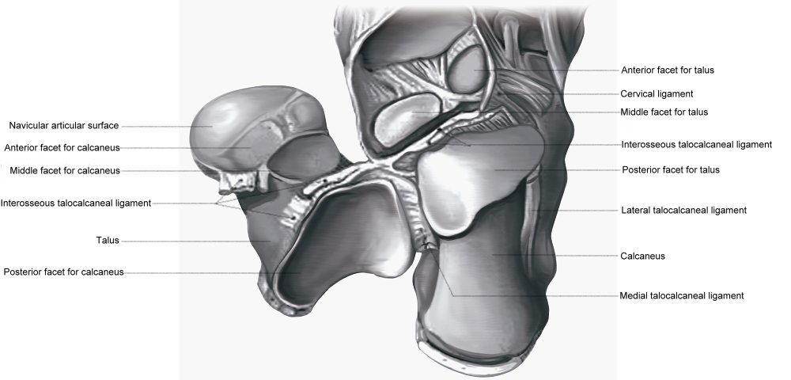
SUBTALAR JOINT /Posterior talo-calcanean joint
Ligaments
Capsule
Medial and lateral talo-calcanean ligaments
Interosseous talo-calcaneanligament
Cervical ligament

Slide 31
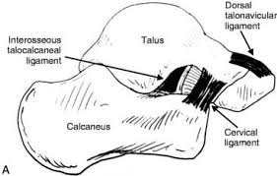
Interosseous talo-calcanean ligament
Cervical ligament

Slide 32
Midtarsal or transverse tarsal joints
TRANSVERSE TARSAL
JOINT
(MIDTARSAL JOINT)
CALCANEO-CUBOID
JOINT
TALONAVICULAR JOINT

Slide 33
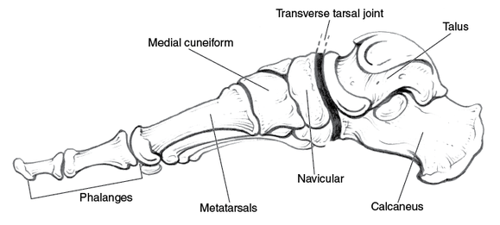
Midtarsal or transverse tarsal joint
Talonavicular joint
Calcaneocuboid joint
Medial view of foot

Slide 34
Talo-calcaneo-navicular joint
Restricted ball and socket type of joint
Ligaments
Talo-navicular ligament
Plantar calcaneo-navicular
Calcaneo-navicular part of bifurcated ligaments

Slide 35
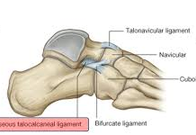
The bifurcated ligament
Y-shaped band.
Its stem attached proximally to
the anterior part of the upper
calcaneal surface
Distally it divides into 2 limbs - calcaneocuboid and calcaneonavicular parts.
The calcaneocuboid ligament extends to the dorsomedial aspect of the cuboid
The calcaneonavicular ligament is attached to the dorsolateral aspect of the navicular

Slide 36
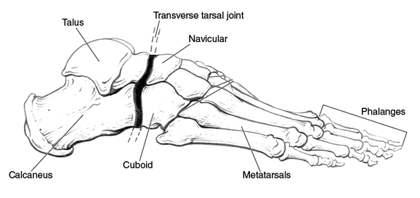
Midtarsal or transverse tarsal joints
Talonavicular joint
Calcaneocuboid joint
Lateral view of foot

Slide 37
CALCANEOCUBOID JOINT
Saddle or sellar joint.
Between anterior surface of calcaneus & posterior surface of cuboid
CALCANEOCUBOID JOINT

Slide 38
Ligaments
Capsule
Calcaneocuboid part of bifurcate ligament
Long plantar ligament
Short plantar or Plantar calcaneocuboid ligament

Slide 39
BIFURCATE LIGAMENT
DORSAL CALCANEOCUBOID
LIGAMENT
CALCANEOCUBOID JOINT

Slide 40
SHORT PLANTAR
LIGAMENT
(Plantar
calcaneocuboid
ligament)
LONG PLANTAR LIGAMENT
PLANTAR VIEW

Slide 41
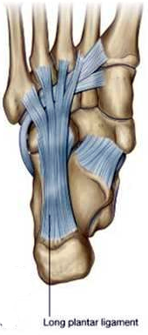
Medial
Lateral
The longest ligament associated with the tarsus.
From Plantar surface of the calcaneus to plantar surface of the cuboid
The deep fibres are attached to the cuboid and more superficial fibres to the bases of the 2nd, 3rd and 4th and sometimes fifth, metatarsals.
Long plantar
ligament

Slide 42
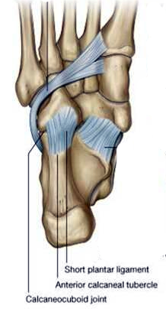
Plantar calcaneocuboid ligament
Is deeper than the long plantar ligament
From the anterior calcaneal tubercle to
the cuboid

Slide 43
Movements
INVERSION
EVERSION

Slide 44
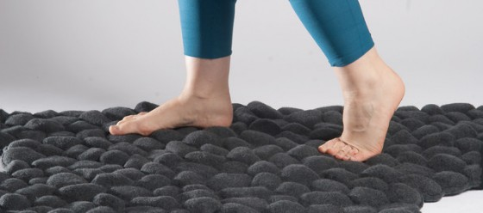
Inversion & Eversion
These movements are essential to adjust the foot while
walking on uneven surface.

Slide 45
Inversion
Sole is directed downwards & medially.
Associated with plantar flexion

Slide 46
Eversion
Sole is directed downwards & laterally.
Associated with dorsiflexion

Slide 47
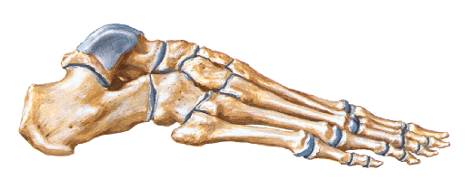
Joints on which it occurs
Subtalar joint
Transverse tarsal joint.
Talo-calcaneo-navicular joint
Lateral view
Medial view

Slide 48
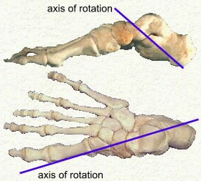
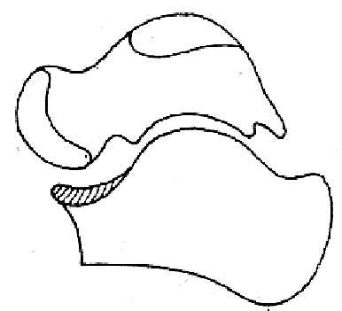
Axis of movement
Passes obliquely upwards, forward & medially
from the heel end of calcaneus through sinus tarsi to dorso-medial surface of neck of Talus

Slide 49
Muscles causing Inversion
Tibialis Anterior
Tibialis Posterior

Slide 50
Muscles causing Eversion
Peroneus longus
Peroneus brevis
Peroneus tertius

Slide 51
EVERSION LIMITED BY
DELTOID LIGAMENT
TIBIALIS ANTERIOR
TIBIALIS POSTERIOR
Medial view of the skeleton of foot

Slide 52
INVERSION LIMITED BY
LATERAL TALO-
CALCANEAL
LIGAMENT
CERVICAL LIGAMENT
CALCANEOFIBULAR
LIGAMENT
PERONEUS LONGUS
PERONEUS BREVIS
Lateral view of the skeleton of foot

Slide 53
APPLIED ANATOMY
Ankle sprains :
Lateral Ankle Sprains caused by Over inversion of foot, which is common causes anterior talo-fibular & calcaneo - fibular ligaments to tear.
a/k/a Low Ankle sprain
Medial Ankle Sprains When foot is forcibly everted fibres of deltoid ligament are torn.

Slide 54
