Slide 1
PBL – Papulosquamous Diseases
Dr N K KANSAL

Slide 2
The Problem
A 50-year-old male patient
Presents with a history of skin lesions x 34 years
Red, itchy, scaly, lesions present all over the body & head
Lesions increase in summer but improve in winter
No joint pains
On clinical examination: BSA: 15% apprx.; Erythematous, scaly, sharply demarcated, plaques, present particularly over the extensor surfaces & scalp
Palms & soles: largely spared

Slide 3
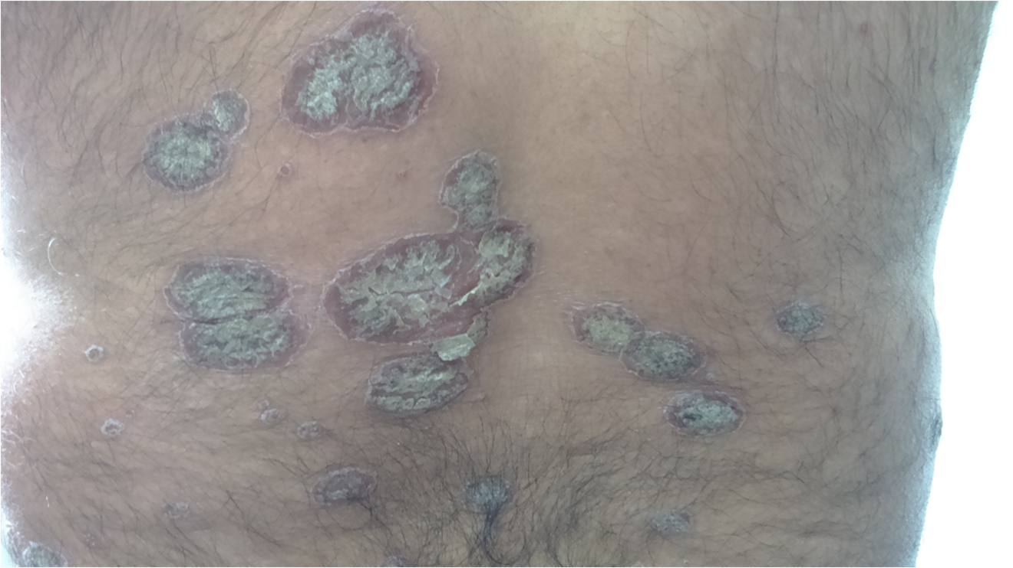

Slide 4
D/D & D

Slide 5
Type 1 - hereditary, strongly HLA associated (particularly HLA‐Cw6), early onset & more likely to be severe
Type 2 - sporadic, HLA unrelated, of late onset & often mild

Slide 6
How to Quantify involvement

Slide 7
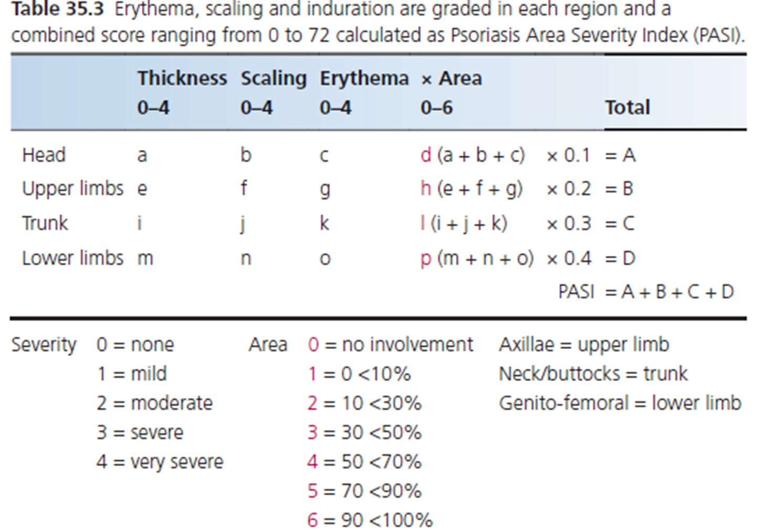
PASI

Slide 8
PASI – 10
Moderate

Slide 9
Tests / Sign

Slide 10
Grattage test - Scales in a psoriatic plaque can be accentuated by grating with a glass slide
Auspitz sign- 3 steps
Step A: Gently scrape lesion with a glass slide - This accentuates the silvery scales (Grattage test positive). Scrape off all the scales
Step B: Continue to scrape the lesion – A glistening white adherent membrane (Burkley’s membrane) appears
Step C: On removing the membrane, punctate bleeding points become visible - positive Auspitz sign

Slide 11
How to treat this patient

Slide 12
Systemic antibiotics in psoriasis

Slide 13
Anti-Streptococcus medications – may clear guttate attacks

Slide 14
Diet in Psoriasis

Slide 15
No clear evidence for / against oral zinc, fish oils, omega-3 fatty acids, turkey meat or diets low in tryptophan, protein or calories
Some studies demonstrate celiac diseases associated-antibodies – elimination of wheat from diet may bring long-term remissions

Slide 16
Treatment options

Slide 17
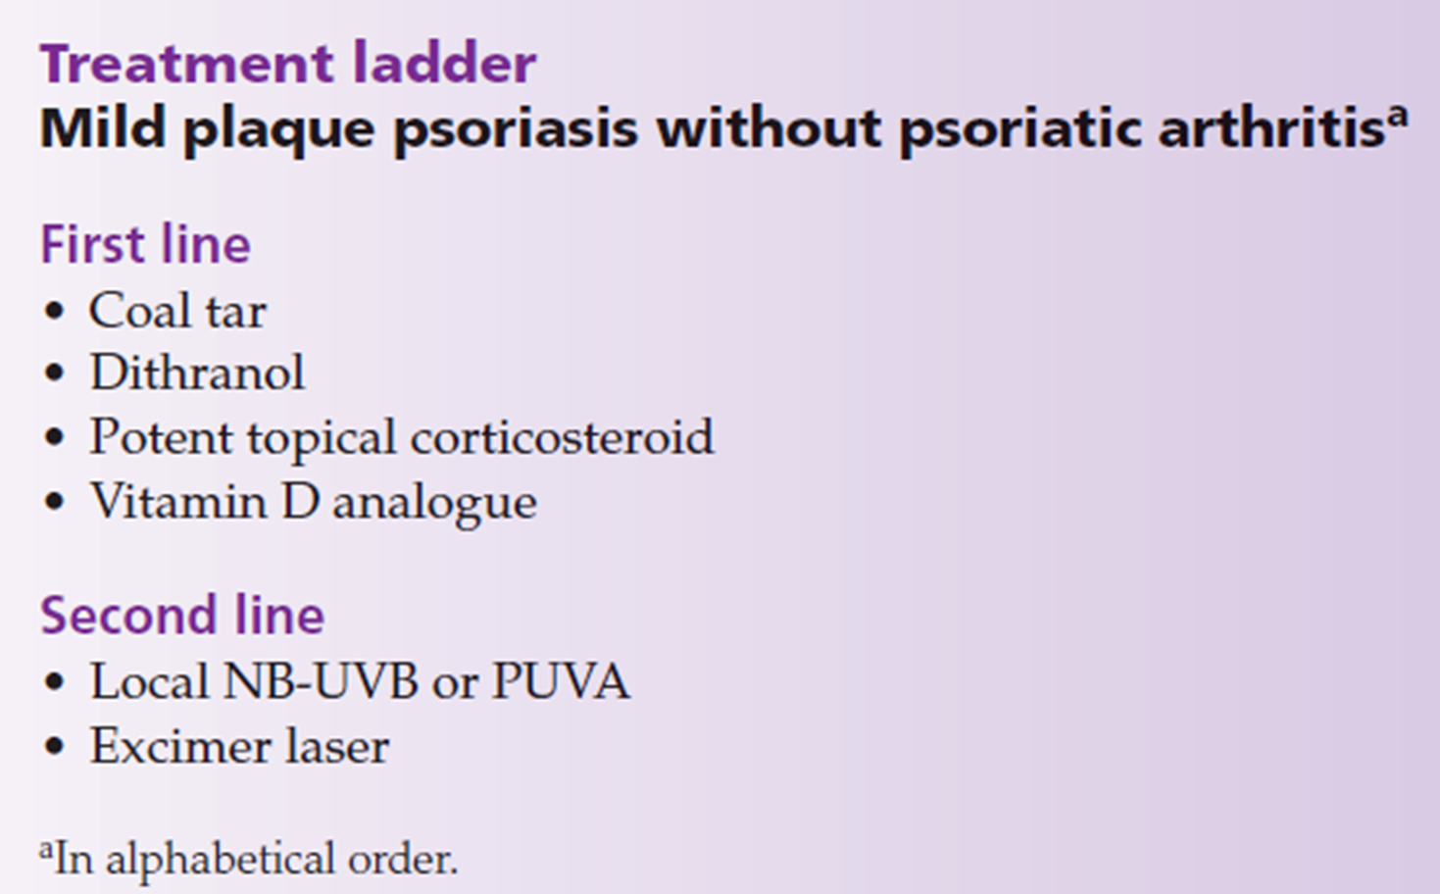

Slide 18
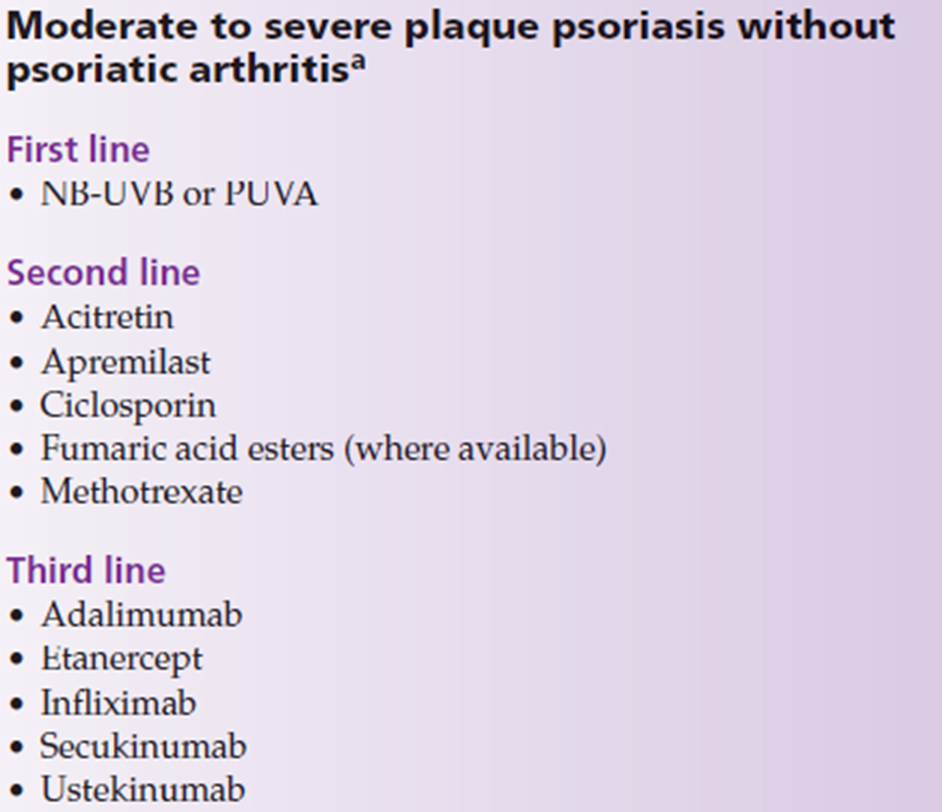

Slide 19
Topical therapy

Slide 20
Emollients - prevent & treat xerosis, decrease scaling
Moisturizing agents - cream bases, coconut / olive oil, white soft paraffin & liquid paraffin mixtures etc.

Slide 21
Investigations

Slide 22
Systemic therapy

Slide 23
Why

Slide 24
Initiation of systemic therapy - a shared decision between the patient & the clinician
Careful consideration of risk–benefit profiles of available treatments
In general, systemic treatment indicated for - extensive disease not responsive to topical therapy or phototherapy; erythroderma; pustular psoriasis; psoriatic arthritis
Impact of disease – patient may opt for earlier systemic treatment
Logistics - e.g., inability to attend for regular phototherapy

Slide 25
Investigations:
CBCs with ESR & PBF
LFTs, RFTs, FBS/RBS, HBA1c, Urine R/E, M/E
HBsAg, HCV, HIV-1 & 2
CXR-PA
Other investigations

Slide 26
Systemic Steroids

Slide 27
When systemic steroid is given for 1st time, clearance of psoriasis is rapid but the disease eventually ‘breaks through’, necessitating progressive increases in dosage, with incidence of side effects
If withdrawal is attempted, psoriasis tends to relapse promptly & may ‘rebound’
‘Rebound’ may take the form of widespread, eruptive psoriasis, erythrodermic psoriasis or generalized pustular psoriasis

Slide 28
Systemic steroids should NEVER be used in the routine care of psoriasis
Psoriasis may remain labile & treatment resistant for many months after the withdrawal

Slide 29
Oral or parenteral corticosteroids should generally be avoided
Used only when urgent control of complications is needed (e.g., acute respiratory distress syndrome)
Or when other drugs are contraindicated for instance in pregnancy
Short‐term effects of prednisolone (30–40 mg/day) may be good but serious relapses are liable to occur as the dosage is reduced unless another form of therapy (e.g., acitretin, TNFi) is given simultaneously

Slide 30
Counselling

Slide 31
Psoriasis – a treatable but incurable disease
‘Psoriasis is at all times and under all forms a very troublesome and, often, an intractable disease, but it is rarely dangerous to life’– Wilson, 1842
‘It is impossible to say, in any particular case, how long the disease will last, whether a relapse will occur, or for what period of time the patient will remain free from psoriasis’– Hebra, 1868
Patients’ counseling – paramount

Slide 32
Papulosquamous Diseases
Psoriasis
Pityriasis rosea
Lichen planus
Erythroderma
Pityriasis lichenoides
Pityriasis rubra pilaris
Parapsoriasis

Slide 33
Erythroderma
Erythroderma is a morphological diagnosis characterized by generalized erythema and scaling
Diffuse erythema and scaling of the skin involving more than 90% of the total body skin surface area
Erythroderma is the term applied to any inflammatory skin disease that affects more than 90% of the body surface

Slide 34
Thank You

