Slide 1
Mycobacterium tuberculosis

Slide 2
Introduction
MYCOBACTERIA:
They are slender rods
Sometimes branching resembling fungal mycelium.
In liquid cultures, they form a mould like pellicle.
Aerobic, Noncapsulated, Nonsporing, Nonmotile
The genus ' mycobacterium ' includes obligate parasites, opportunistic pathogens, saprophytes.

Slide 3
History
First to be identified is Lepra bacillus discovered by Hansen in 1868.
ROBERT KOCH in 1882
Isolated the mammalian tubercle bacillus and proved its causative role in Tuberculosis by satisfying
KOCH'S POSTULATES.

Slide 4
Koch’s Postulates
A micro organism can be accepted as the causative agent of an Infectious Disease only if the following conditions are satisfied.
The bacterium should be constantly associated with the lesions of the disease.
It should be possible to isolate the bacterium in pure culture from the lesions.
Inoculation of such pure culture into suitable laboratory animals should reproduce the lesions of the disease.
It should be possible to re-isolate the bacterium in pure culture from the lesions produced in the experimental animals.

Slide 5
Classification of Mycobacteria
MTC – Human, Bovine, Africanum, Microti
M. leprae
Atypical mycobacteria
Saprophytic mycobacteria
MTC
MOTT

Slide 6
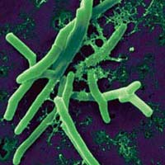
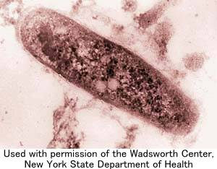
M. tuberculosis
Straight or slightly curved 3x0.3 μm in size
Occurring singly, In pairs or in small clumps.
Size depends on conditions of growth.
Long filamentous, club shaped, branching forms may sometimes be seen.
M. bovis is straighter, shorter and stouter

Slide 7
Staining Characterstics
Ziehl Neelsen staining - Acid fast bacilli.
Acid fastness – Resisting decolorisation by weak mineral acids like H₂SO₄ / HCL
Both by ZN method and Fluorescent staining, Acid fastness is due to the presence of lipid rich waxy cell wall [Mycoloic acid] or due to the semi permeable membrane around the cell.
Beaded or barred forms are frequently seen
Cell wall is thick, Composed of three layers enclosing a trilaminar plasma membrane.
Spheroplasts are formed when grown in the presence of lysozyme, L forms are also seen.

Slide 8
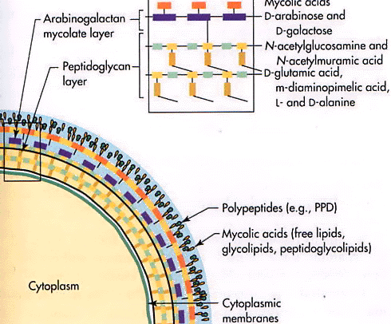
Lipid-Rich Cell Wall of Mycobacterium
Mycolic acids

Slide 9
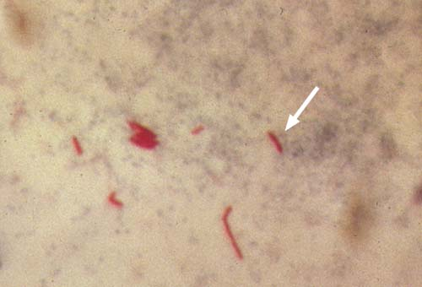
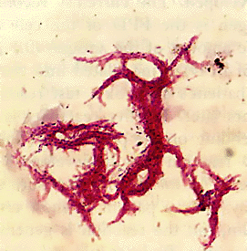

Slide 10
Cultural Characteristics
Bacilli grow slowly
Generation time 14 – 18 hours.
Optimum temperature 37ºC
Growth does not occur below 25ºC and above 40ºC .
Obligate aerobes, Optimum PH 6.4 – 7
Addition of 0.5 % glycerol improves the growth.
Sodium pyruvate also helps in growth
Highly susceptible to toxic substances: Fatty acids
Colonies appear in 2-8 weeks.

Slide 11
Colony Morphology
On solid media, forms
Dry
Rough
Raised
Irregular colonies with wrinkled surface.
On further incubation forms Creamy white
Yellowish
Buff coloured colonies
Not easily emulisifiable

Slide 12
Solid Culture Media
Common solid media LOWENSTEIN - JENSEN medium
Solid media - Egg media
LJ, Petrognini, Dorset
Blood - Tarshis
Serum – Loeffler’s Serum Slope
Potato - Pawlowsky

Slide 13
Liquid Culture Media
On liquid media without dispersing agents forms a prominent surface pellicle which may extend along the sides above the medium – Hydrophobic nature of cellwall
Virulent strains tend to form long serpentine cords. [Cord Factor]
Sula’s, Middlebrook’s 7H9, Kirchner’s and Dobo’s
Selective agents – PANTA - PACT

Slide 14
Resistance
Not especially heat resistant.
Killed at 60ºC in 15 - 20 minutes.
Cultures may be killed by exposure to direct sunlight for 2 hrs.
Sputum - Remain alive for 20 - 30 hrs.
Droplet nuclei - Retain viability for 8 - 10 days
Cultures - Viable at room temperature for 6 - 8 months and may be stored for upto 2 yrs at - 20ºC.
Survives exposure to 5% Phenol , 15 % Sulfuric acid, 3% Nitric acid, 5% Oxalic acid, 4% Sodium hydroxide.
Sensitive to Formaldehyde and Glutaraldehyde.
Destroyed by Tincture of iodine in 5 min and by 80% Ethanol in 2 - 10 min.

Slide 15
Biochemical Reactions
Niacin Test:
Form niacin in Egg medium
10% Cyanogen bromide + 4% Aniline + 96% Ethanol to culture suspension = Canary Yellow [Positive]
Eg. M. tb, M. microti, M. simiae, M. cheloneii
Aryl sulphatase test:
When grown in medium containing 0.001 M
K₃ phenolphthalein disulphate + 2N NaOH = Pink
Eg. Atypical mycobacteria

Slide 16
Biochemical Reactions
Neutral red test:
Virulent strains of tubercle bacilli are able to bind neutral red in alkaline buffer solution, Negative in avirulent strains
Catalase – Peroxidase test:
Equal amounts of 30 vol. H2O2 + 0.2% Catechol + Dist water to 5 ml of test culture =
Effervescence – Catalase Positive
Eg. Atypical mycobacteria
Browning – Peroxidase activity
Eg. M. tuberculosis
Importance: Both are negative in INH resistance

Slide 17
Biochemical Reactions
Amidase test:
Ability to split amides
Acetamide, Benzamide, Carbamide, Nicotinamide, Pyrazinamide
0.00165 M Amide solution + Bacillary suspension incubated at 37ºC
+ 0.1 ml MnSO₄ + 1 ml Phenol + 0.5 ml Hypochlorite solution and kept in boiling water for 20 minutes = Blue
Eg. Pyz’ase +ve M. bovis BCG

Slide 18
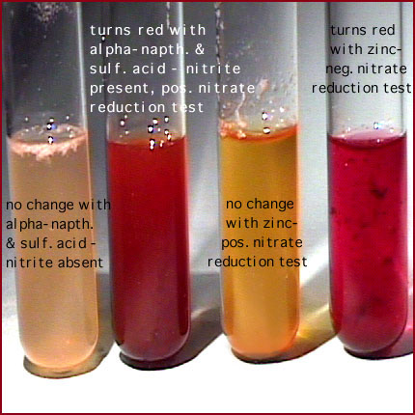
Biochemical Reactions
Nitrate reduction test:
Positive in M. tuberculosis
Negative in M. bovis

Slide 19
Antigenic Properties
Group Specificity: Polysaccharide antigens
Type Specificity: Protein antigens.
DTH - Bacillary protein (Tuberculin)
Some degree of antigenic relationship exists between tubercle bacilli, lepra bacilli and atypical mycobacteria, as shown by weak cross reactions in skin testing with different tuberculins.
Serological tests - M.tuberculosis strains are antigenically homogenous and similar to M. bovis, microti
Antibodies to Polysaccharide, Protein, Phosphatide are produced, But not significant in Immunity or Diagnosis.

Slide 20
Types
Bacteriophage types:
A, I, B, C
Bacteriocin types:
2 types
Molecular typing:
Restriction endonuclease – RFLP
Entire genome of tubercle bacillus has been sequenced

Slide 21
Hosts
Highly infectious for guinea pigs, hamsters
Natural infection in humans, dogs, primates
Non pathogenic for rabbits, cats, goats, bovines and fowl
Mice are moderately susceptible
M. bovis – Cattle, dogs, cats, badgers, swine, parrots, birds and humans.
But nonpathogenic for fowl
M. africanum – Africa
M. microti - Voles

Slide 22
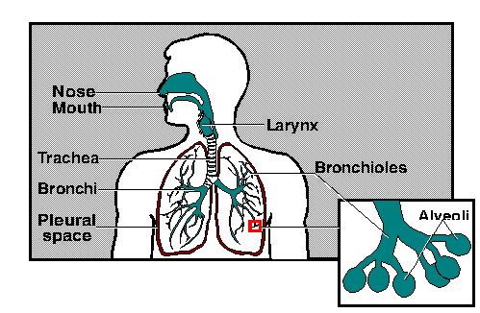
Pathogenisis
Source – Open case of TB
Sputum – 10000 Bacilli/ml
25 cases before death or cure
Aerosols – 3000 Bacilli/Cough
Rarely – Infected milk, inoculation
90% of those infected with Mycobacterium tuberculosis are asymptomatic, [LTBI] with only a 10% lifetime chance that a latent infection will progress to TB disease.
Factors – Number, virulence of infecting bacilli, genetic susceptibility, age, immunocompetence, stress, nutrtion, co-morbid illnesses.
Untreated, the death rate > 50%.

Slide 23
Mechanisms of Virulence
TB mechanism for cell entry
The tubercle bacillus can bind directly to mannose receptors on macrophages via the cell wall-associated mannosylated glycolipid (LAM)
TB can grow intracellularly
Once TB is phagocytosed, it can inhibit phagosome-lysosome fusion
Slow generation time
Immune system cannot recognize TB, or cannot be triggered to eliminate TB

Slide 24
Mechanisms of Virulence
High lipid concentration in cell wall
Accounts for impermeability and resistance to antimicrobial agents
Antigen 85 complex
It is composed of proteins secreted by TB that can bind to fibronectin.
These proteins can aid in walling off the bacteria from the immune system
Cord factor
Associated with virulent strains of TB
Toxic to mammalian cellls

Slide 25
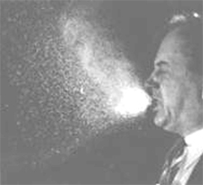
Pulmonary Tuberculosis
TB infection begins when the mycobacteria reach the Pulmonary alveoli where they are ingested by and replicate in alveolar macrophages.
Bacteria are picked up by dendritic cells, which do not allow replication, although these cells can transport the bacilli to local ie. Mediastinal lymphnodes
Immunity – Cell mediated by CD⁴⁺T helper cells [Th1 and Th2 cells] and their cytokines like IL γ, 1, 2 and TNF α.
Th1 – Cytokines activate macrophages, containment, protective.
Th2 – Cytokines lead to DTH, tissue destruction, progression of disease.
The lesion which is produced is called a Granuloma or a Tubercle

Slide 26
Tuberculosis is a granulomatous inflammatory condition.
Granuloma is avascular with lymphocytes and fibroblasts
surrounding the infected, fused [Giant] macrophages.
Exudative - DTH
Productive - Protective
The granuloma functions
1) Prevent dissemination of the mycobacteria,
2) T lymphocytes (CD4+) secrete cytokines such as interferon gamma
which activates macrophages to destroy the bacteria
with which they are infected.
3) T lymphocytes (CD8+) can also directly kill infected cells

Slide 27
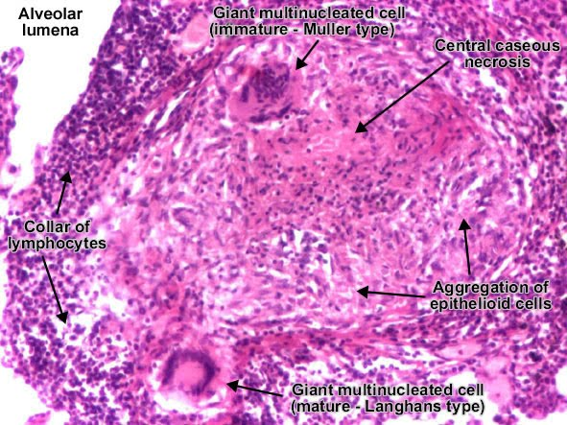
Granuloma

Slide 28
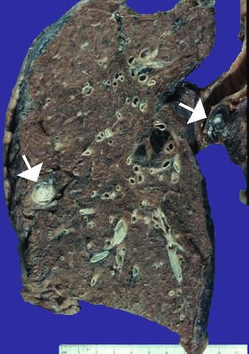
Tuberculosis
Can be classified into
Primary
Post primary
Depending on Time of infection and
type of response
Primary tuberculosis: In endemic areas, in young children leads to formation of Ghon focus.
Primary complex: Ghon focus+Lymph nodes
Formed in 3-8 weeks of infection, Heals in 2-6 months by calcification.
Sometimes the live bacilli may lie dormant and progress depending on the host’s immune status leading to Post primary tuberculosis.

Slide 29
Tuberculosis
Post primary or Adult or Secondary TB:
Reactivation of latent infection
Exogenous reinfection
Affects mainly the upper lobes, tissue destruction, cavitation, LN are not involved.
Open cases of TB – Spread of TB
In the immunodeficient – No cavity formation, But widespread infection in many organs and systems.

Slide 30
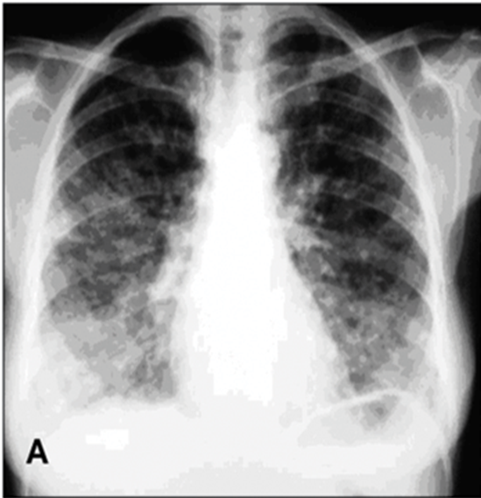
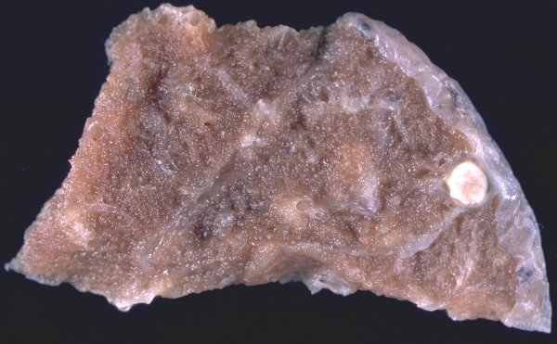
Granuloma & TB Lung

Slide 31
Miliary Tuberculosis
Area of damaged tissue
Bloodstream
Set up many foci of infection as tiny white tubercles in the tissues, organs

Slide 32
Miliary Tuberculosis
Miliary Tuberculosis

Slide 33
Extrapulmonary Tuberculosis
The most common sites affected:
Lymph nodes
Bones
Serous membranes
Most serious forms of spread are disseminated TB and tuberculous meningitis

Slide 34
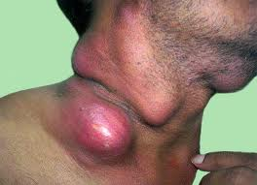
TB Lymphadenitis
Lymph nodes are most commonly affected
Cervical
Mediastinal
Axillary
Inguinal
Nodes are usually mobile and painless but become matted with time

Slide 35
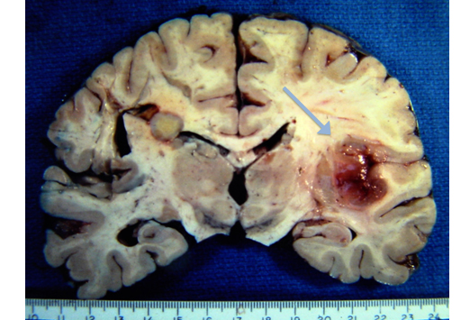
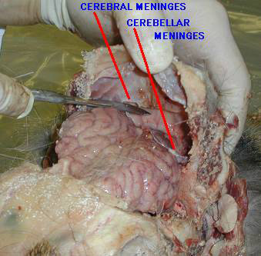
Central Nervous System Disease
Tuberculous meningitis commonly occurs after a primary infection in childhood or as a part of miliary tuberculosis
Local source of infection is a caseous focus in meninges or brain substance adjacent to CSF pathway
The specimen collected for diagnosis is CSF

Slide 36
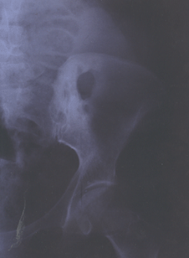
Bone And Joint Disease
Spine is most common site
Chronic back pain and involves lower thoracic and lower spine
Pott’s disease
Infection starts as Discitis-Spinal ligaments-Vertebral bodies-Angulation of vertebrae with kyphosis
CT is valuable in gauging the extent of disease
Hip and knee joints are commonly affected

Slide 37
Gastrointestinal Tuberculosis
TB may affect any part of bowel
Ileocaecal disease accounts for half of TB cases
Tuberculous peritonitis
Mesenteric lymphadenitis
Abdominal distension, Fever, Vomiting, Constipation
Laparoscopy reveals multiple white tubercles over peritoneal and omental surfaces
Low grade hepatic dysfunction is common in miliary disease.

Slide 38
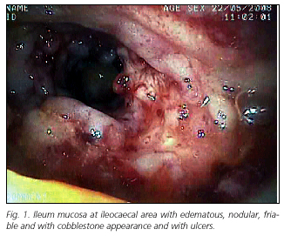
Splenic / GIT Tuberculosis

Slide 39
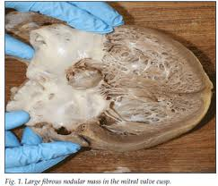
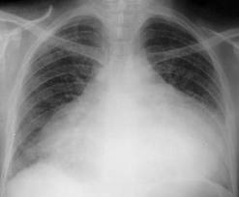
Cardiac TB
Disease occurs in two forms
Pericardial effusion
Constictive pericarditis
Raised JVP
Heptomegaly
Prominent ascites
Diagnosis on Clinical, Radiological & Echocardiographic findings
The pericardial effusion is blood stained in 85% of cases

Slide 40
Genitourinary Disease
Haematuria
Frequency and dysuria
Sterile pyuria found on urine microscopy and culture
In women infertility from endometritis
Pelvic pain
Swelling from salpingitis occur occasionally
In men genitourinary TB may present as epididymitis or prostatis

Slide 41
Epidemiology
Tuberculosis is an ancient disease .
Evidence of spinal tuberculosis is present in some Egyptian mummies.
Tubercle bacillus DNA has been detected by molecular analysis in a mummy dated circa 1550 - 1080 B.C.
Tuberculosis has been for many centuries the most important of human infections, in its global prevalence, Devastating morbidity and massive mortality.
It has been called the '' White Plague '' and '‘The captain of all the men of death ''

Slide 42
Epidemiology
Poverty
Lesser in affluent nations, More in developing
AIDS – Worsened the scenario
Multi-drug resistance
WHO 1993 – As a global emergency
Human infection with M. bovis is worldwide
Through aerosolised route between animals
To human by MILK
Can affect any system
Prevented by pasteurization
No Human-Human transmission

Slide 43
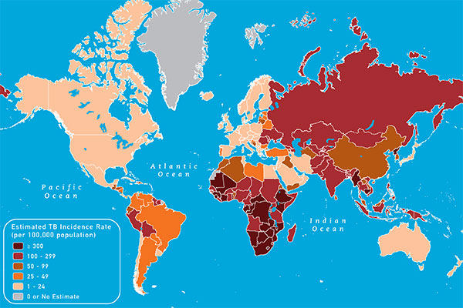

Slide 44
Laboratory Diagnosis
Microscopy
Culture
Animal Inoculation
Demonstration of hypersensitivity to
tuberculo-protein [Mantoux test]
Molecular diagnostic methods
Supportive evidence (CBC, ESR, CT, MRI)

Slide 45
Diagnosis of TB
Specimen
Respiratory
Sputum
Gastric washing (Mainly used for children)
Broncho-alveolar lavage
Transbronchial biopsy
Non respiratory
Fluid examination (Cerebrospinal, Ascitic, Pleural, Pericardial, Synovial fluid, Urine)
Tissue biopsy (From affected site, Bone marrow liver may be diagnostic in disseminated disease)

Slide 46
Decontamination & Concentration of specimens
Petroff’s method
NALC combined with 2% NaOH

Slide 47
Lab Diagnosis Of Pulmonary Tuberculosis
Specimen tested is sputum. [1+1]
Bacillary shedding is abundant in cases with caseation [Atleast 10,000 bacilli/ml].
But relatively scanty in organized lesions that do not communicate with airways.
Sputum is best collected in the morning before any meal.
Where sputum is not available,
Laryngeal swabs
Bronchial washings can be used

Slide 48
Microscopy
Direct smears of sputum are examined.
Smear - Thick purulent part of sputum.
Smears are dried, Heat fixed and stained by ZIEHL-NEELSEN technique.
Under oil immersion objective, acid fast bacilli are seen as bright red rods background is blue, yellow or green depending on the counter stain used.
Positive report - 2 or more typical bacilli have been seen.
When several smears are to be examined - Fluoroscent microscopy.

Slide 49
Ziehl Neelsen Staining
Prepare the smear, Fix
Carbol fuchsin
Acid-Alcohol
Loeffler’s methylene blue
Wash and dry
Microscopy – Single most reliable method for diagnosis and treatment
Ehrlich, Kinyoun’s, Spores etc.
Fluorescent staining

Slide 50
ZN Smear Grading – WHO/RNTCP Criterion

Slide 51
Concentration Methods
Homogenization
Decontamination
They may be classified as:
Methods useful for microscopy
Methods useful for culture and animal inoculation as well.
First group involves treatment with Antiformin, Sodium carbonate or hypochlorite, Detergents like tergitol, Flotation methods using hydrocarbons and the autoclave method.
Kill the bacilli without altering their morphology or staining reaction.

Slide 52
Petroffs Method
Sputum is incubated with an equal volume of 4% sodium hydroxide solution at 37ºC with frequent shaking till it becomes clear on an average for 20 min .
Centrifuged at 3000 RPM for 20 min and the sediment is neutralized with N/10 HCL and used for Smear, Culture and Animal Inoculation.
Excessive exposure to alkali is deleterious.
Sputum is treated with an approximately equal volume of sterile solution containing 20 g cetrimonium bromide and 40 g of NaOH per litre of distilled water.
The contents are mixed with a cotton swab and let stand for 5 min.
About 0.2 ml of the inoculum is smeared firmly with the swab over the entire surface of acid buffered IUAT - LJ medium.
Dilute acids - 6% Sulfuric Acid, 3 % HCL or 5 % Oxalic Acid
N acetyl cysteine with NaOH, Pancreatine, Desogen
Zepharin and Cetrimide.
Flocculation methods are also done.

Slide 53
Culture
Very sensitive diagnostic technique for tubercle bacilli, detecting as few as 10 - 100 bacilli per ml.
Concentrated material is inoculated on to atleast 2 bottles of IUAT - LJ medium.
If the specimen is positive by microscopy, a direct drug sensitivity test may also done.
Cultures are examined for growth after incubation at 37ºC for 4 days for rapid growing mycobacteria and atleast twice weekly thereafter 8-12 weeks.
Any growth - ZN staining, Biochemical reactions.
The use of liquid media with radio metric growth detection (Such as BACTEC, Bact-alert)
MGIT
Nucleic acid probes have simplified culture, Results to be given in 2 - 3 weeks.

Slide 54
Tests for Identification
Type | Niacin | Nitrate Reduction | O₂ Preference | Growth in TCH | Phage type
Human | + | + | Aerobic | + | ABC
Asian type | + | + | Aerobic | - | I
African type | +/- | Variable | MA | - | A
Vole | +/- | Variable | MA | - | ?
Bovine | - | - | MA | - | A

Slide 55
Tests for Identification
Species | Glycerol Enhanced | Pyruvate Enhanced | Niacin Prodction | Pyrazinamide Sensitivity | O2 Preference | Pathogenicity
M. tuberculosis | YES | YES | YES | SENSITIVE | AEROBIC | PATHOGENIC
M. bovis | NO | YES | NO | RESISTANT | MICRO | PATHOGENIC
M. africanum | NO | YES | Variable | SENSITIVE | MICRO | PATHOGENIC
M. microti | Variable | YES | YES | SENSITIVE | AEROBIC | NON PATHOGENIC
BCG | YES | YES | NO | RESISTANT | AEROBIC | OPPORTUNIST

Slide 56
Sensitivity Tests
Absolute concentration method
Number of media containing serial concentrations of drugs are inoculated and the minimum inhibitory concentrations calculated.
Resistance ratio method
2 sets of media containing graded concentrations of drugs are inoculated , One set with the test strain and the other with a standard strain of known sensitivity.
Proportion method
Indicates the average sensitivity of the strain, taking into account the fact that any population will contain cells with varying degrees of sensitivity to a drug.

Slide 57
Animal Inoculation
The concentrated material is inoculated intramuscularly into the thigh of two healthy guinea pigs about 12 weeks old
The animals are weighed before inoculation and at intervals thereafter.
Progressive loss of weight is an indication of infection.
4 Weeks
8 Weeks
Infected animals show a positive tuberculin skin reaction.

Slide 58
Nucleic Acid Technology
Polymerase chain reaction
Ligase chain reaction are used as diagnostic techniques.
Transcription mediated amplification ,
Targeting ribosomal RNA
The use of RFLP and IS fingerprinting for epidemiological typing of strains
Demonstration of mutation in specific drug sensitivity genes is a useful indicator of drug resistance.
Immunodiagnosis
Serological tests are not useful in diagnosis, though antibodies to many bacillary antigens have been demonstrated in the sera of patients.
Detection of antibody to mycobacterial lipo -arabinomannan has been reported to be of same value.

Slide 59
Allergic Tests
Koch phenomenon
Koch prepared a protein extract of tubercle bacillus by concentrating tenfold by evaporation
A 6-8 week culture filtrate of the bacillus grown in 5% glycerol broth.
This was called original or old tuberculin.
Von pirquet [1906]
Purified protein antigen ^PPD ^ PPD-S [1939]
50,000 TU/mg
1 TU = 0.01ml OT Or 0.00002mg of PPD-S
Mantoux, Heaf and Tine methods

Slide 60
Mantoux Test
0.1ml Purified Protein Derivative (PPD)
of Tubercle bacillus antigen --- 5 T.U
Intradermally in flexor aspect of Lt fore arm
RAISED WHEAL Read at 48 -72 hours
Positive
Induration is 10 mm OR more
Negative 5mm or less
Equivocal 6 to 9mm

Slide 61
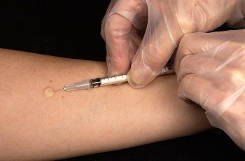
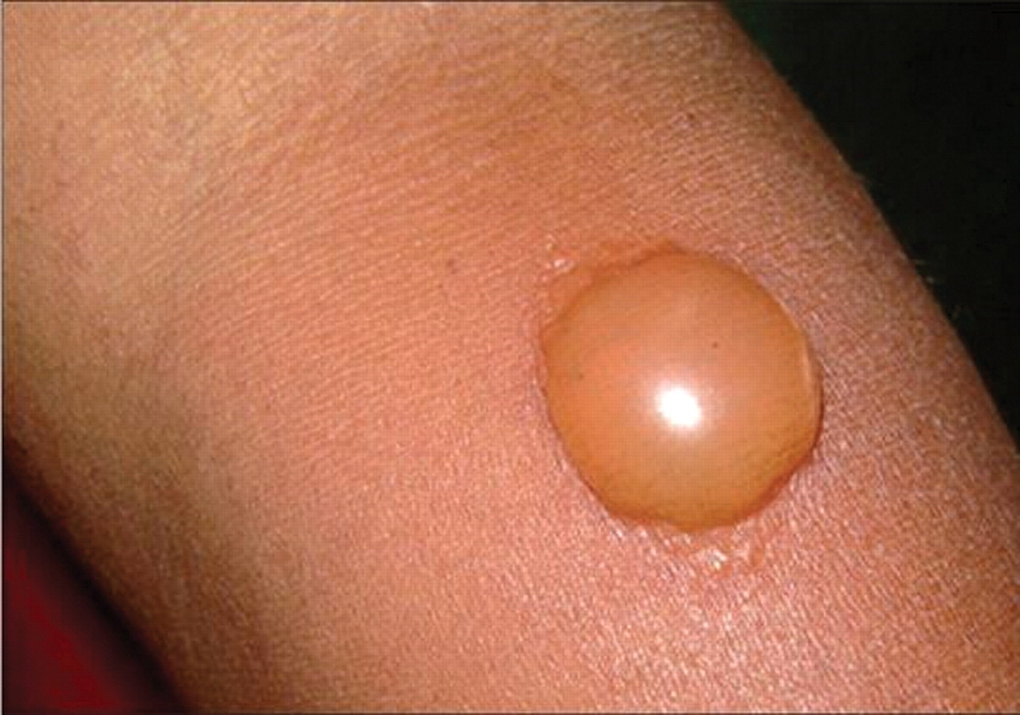
A positive tuberculin test indicates hypersensitivity to tuberculoprotein - Infection with tubercle bacillus or BCG immunisation, recent or past, with or without a clinical disease.
The test becomes positive 4-6 weeks after infection or immunisation.
Tuberculin allergy wanes in 10-12 years.

Slide 62
False negative tests (anergy):
Miliary TB
New born & elderly
HIV
Recent infection
Malnutrition
Immunosuppressive therapy
Lymphoreticular malignancy
Sarcoidosis
Measles
False positive tests:
In infections with some related mycobacteria (Atypical mycobacteria)

Slide 63
Extra Pulmonary TB
Microscopy, Culture, Animal inoculation
CSF – PCR, DNA Probes
Blood, Bone Marrow & Liver biopsy specimen – Miliary, HIV Co-infection
Renal tuberculosis – 3 to 6 morning samples
Fluids – Centrifugation

Slide 64
Prophylaxis - Control
Adequate nutrition, Good housing, Health education are as important as antibacterial measures.
Immunoprophylaxis is by intradermal injection of the attenuated vaccine developed by Calmette and Guerin, Bacille Calmette Guerin or BCG
Early detection and treatment

Slide 65
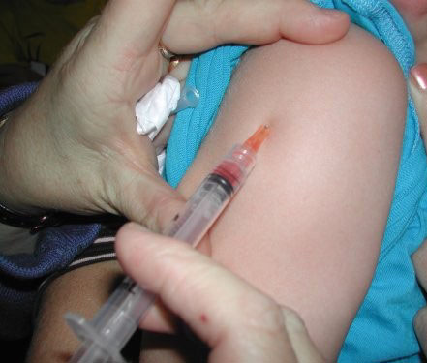
BCG Vaccine
Bacille Calmette Guerin 1906 - 13 Years
Oral: 1921-25
ID: 1927
Dosage: Usual strength is o.1mg/0.1ml volume.
Dosage: Infants ◄ 4 Weeks 0.05ml.
Dose is lesser - Local abscess formation and enlarged regional lymph nodes.
BCG should not be administered after the age of 2 years.
BCG should not be given to infants and children with active HIV disease, though it may be given with benefit to asymptomatic HIV positives.

Slide 66
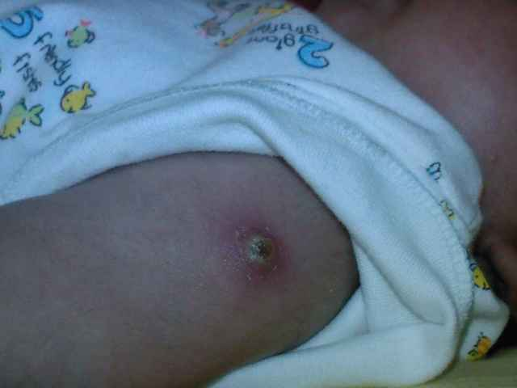
Complications Of BCG
LOCAL: Abscess, indolent ulcer, keloid, tubrculides, confluent lesions, lupoid lesions, lupus vulgaris.
REGIONAL: Enlargement and suppuration of draining lymph nodes.
GENERAL: Fever, mediastinal adenitis, erythema nodosum, tendency to keloid formation after wounding at other sites and very rarely nonfatal meningitis.
Notes:
Talk about chemoprophylaxix

Slide 67
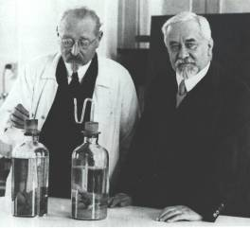
The Need for a New TB Vaccine
BCG developed 90 years ago, not improved upon since
Reduces risk of severe pediatric TB disease, but:
Unreliable protection when given to newborns against adult pulmonary TB, which accounts for most TB worldwide
Wide use, but no apparent impact on the growing global TB epidemic
Not known to protect against latent TB
Not recommended for use in infants infected with HIV
A new, more effective TB vaccine should:
Contribute significantly to global efforts to eliminate TB as a public health threat
Be safer and more effective in preventing TB in children, adolescents and adults, including people with HIV (for whom BCG is unsafe
Protect against all forms of TB – including MDR and XDR
Reduce the cost and burden of TB on patients, health care systems and national economies

Slide 68
Currently 12 novel TB Vaccines are in Clinical Trials
Phase I
Phase II
Phase IIb
Phase III
AERAS-422 Aeras
AdAg85A McMaster University
Hybrid-I+CAF01 SSI
Hyvac 4/ AERAS-404 SSI, Sanofi-Pasteur, Aeras, Intercell\
SSI H56-IC31 SSI, Aeras, Intercell, TBVI
M72+AS01 GSK, Aeras
RUTI Archivel Farma
VPM 1002 Max Planck, Vakzine Projekt Mgmt, TBVI
Hybrid-1+IC31 SSI, TBVI, EDCTP, Intercell
MVA85A/ AERAS-485 Oxford-Emergent Tuberculosis Consortium (OETC), Aeras
AERAS-402/ Crucell Ad35 Crucell, Aeras
Mw [M. indicus pranii (MIP)]
Dept of Biotechnology (India), M/s. Cadila
Prime
Boost
Post-infection
Immunotherapy
TB Vaccine Types
Viral-vectored: MVA85A, AERAS-402, AdAg85A
Protein/adjuvant: M72, Hybrid-1, Hyvac 4, H56
rBCG: VPM 1002, AERAS-422
Killed WC or Extract: Mw, RUTI
2000 | 2002 | 2009 | 2011
No new preventive TB vaccines in clinical trials
1st preventive
vaccine enters clinical
trials (MVA85A)
1st Phase IIb proof-of-concept of preventive vaccine initiated
15 vaccines have entered clinical trials, 12 currently in clinical trials
2000
202
2009
2011
Notes:
68
68

Slide 69
Prevalence of TB
Global incidence rate = 128 cases/100,000
1.4 million TB-related deaths
8.8 million new cases of TB
80% of the TB burden is in 22 countries
TB/HIV co-infection and TB drug resistance are key barriers to progress
TB/HIV: ~2.5 million people with HIV;
About 5% of TB patients estimated to be HIV positive

Slide 70
Tuberculosis Control Programs
NTP: Since 1962
Permanent countrywide program
Integrated with health delivery systems both at urban, rural levels
To reduce the problem of tuberculosis, so that its no more a public health hazard
RNTCP: India+WHO+World Bank [1992]
↑ 85% Cure rate - DOTS
↑ 70% Case detection
Involvement of NGOs
STOP TB 2006-2015 - DOTS

Slide 71
Directly Observed Treatment, Short Course (Dots)
DOTS – Provides most effective medicine
Confirms that it is taken
INTENSIVE PHASE:
Health worker watches as the patient swallows drug in his presence
CONTINUATION PHASE:
The patient is issued medicine for 1 week of which first dose is taken in the presence of health worker.
Notes:
ATT

Slide 72
Drug resistance - Causes
Microbial: As a result of genetic mutation
Caused by random chromosomal mutations at predictable frequencies (→1 H resistant bacilli in 106, R 1 in 108, HR 1 in 1014)
Essentially drug resistance is a man made phenomenon
Providers/Programmes: Inadequate regimens | Drugs: Inadequate supply Poor quality | Patients: Inadequate drug intake
-Absence of guidelines or inappropriate guidelines -Non-compliance with guidelines -Inadequate training of health staff -No monitoring of treatment -Poorly organized or funded TB control programmes | -Non-availability of certain drugs (stock-outs or delivery disruptions) -Poor quality -Poor storage conditions -Wrong dosages or combination | -Poor adherence (or poor DOT) -Lack of information -Non-availability of free drugs -Adverse drug reactions -Social and economic barriers -Malabsorption -Substance abuse disorders

Slide 73
Drug Resistant M. tuberculosis
Multidrug resistance (MDR) (INH and RIF resistance)
Extensively Multidrug resistance (XDR)
MDR-TB and
Resist to atleast 3 classes of injectable second line drugs - ie Capreomycin, Kanamycin, Amikacin.
TDR – First time in Iran in 2009
Recently in India – Mumbai 12 cases, 1 death. [07-01-2012]

Slide 74
Gene location associated Drug-Resistant M.tuberculosis
Drug Gene
Isoniazid Kat G, Inh A, Kas A
Rifampicin rpo B
Ethambutol emb B
Streptomycin rps L
Pyrazinamide pnc A
Fluoroquinolones gyr A
Dubaniewicz A, et al. Molecular sub-type of the HLA-DR antigens in pulmonary tuberculosis. Int J Infect Dis2000;4:129-33.

Slide 75
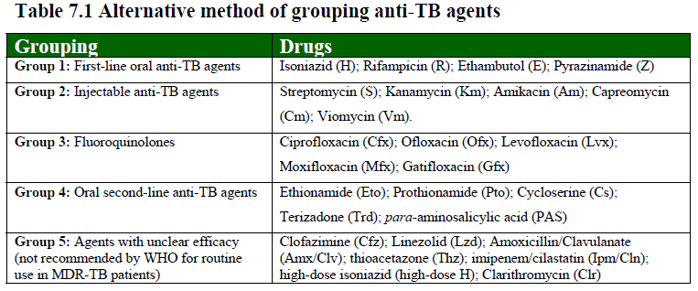

Slide 76
Other MTC Bacteria
M. bovis: TB in cattle, Humans
Small smooth colonies – Eugonic
M. africanum: African variant of M. tb with similar appearance as bovis.
Mainly in africa
M. microti: Vole tubercle bacillus
Rarely isolated from human specimens

Slide 77
DOTS-Plus
Components for MDR-TB diagnosis and treatment using quality assured culture and drug susceptibility testing.

Slide 78
STOP TB Strategy
Achieve universal access to high quality care for all people with TB
Reduce the human suffering and socio-economic burden associated with TB
Support development of new tools and enable their timely and effective use
Protect and promote human rights in TB prevention, care and control.

Slide 79
THANK YOU!

