Slide 1
RADIAL NERVE
Dr MUKESH SINGLA
Additional Professor
Anatomy
AIIMS Rishikesh

Slide 2
Learning Objectives
Origin and root value of radial nerve.
Course and relations of radial nerve.
Branches and structures supplied by radial nerve.
Effects of lesion of radial nerve.

Slide 3
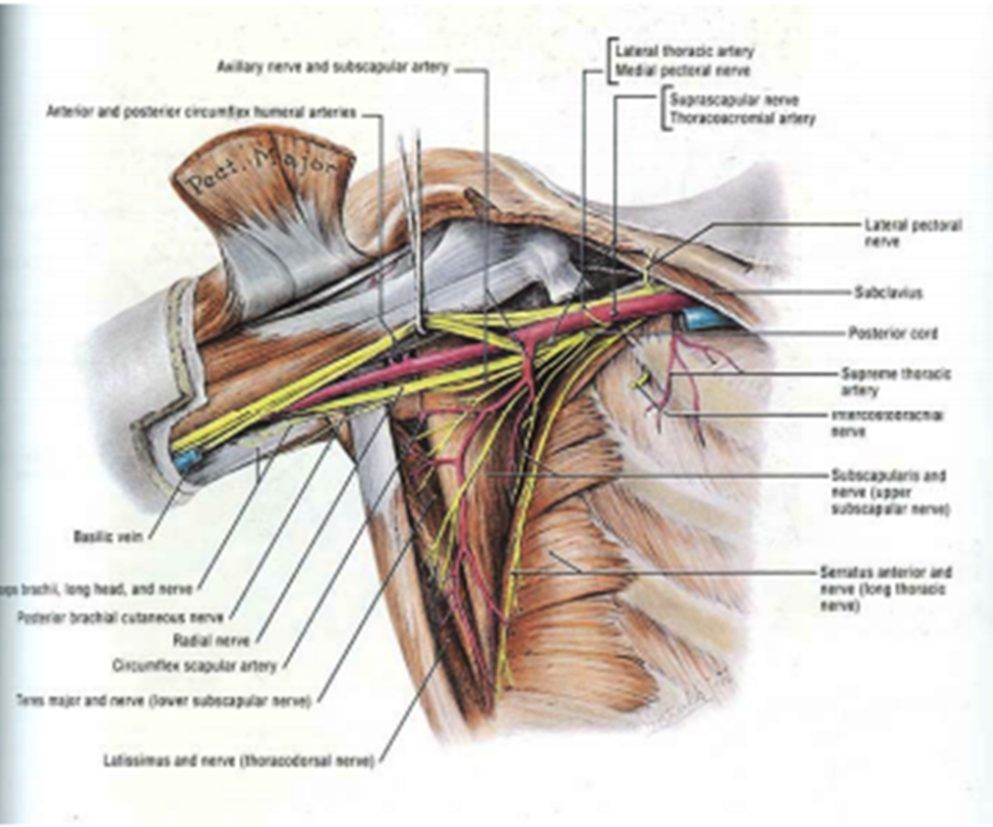

Slide 5
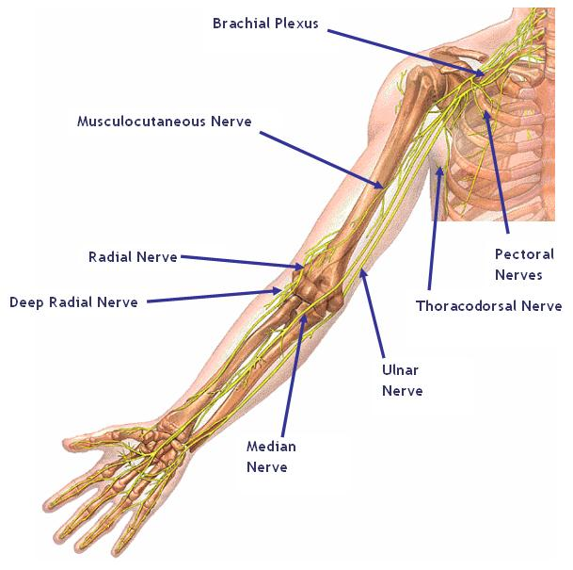

Slide 8
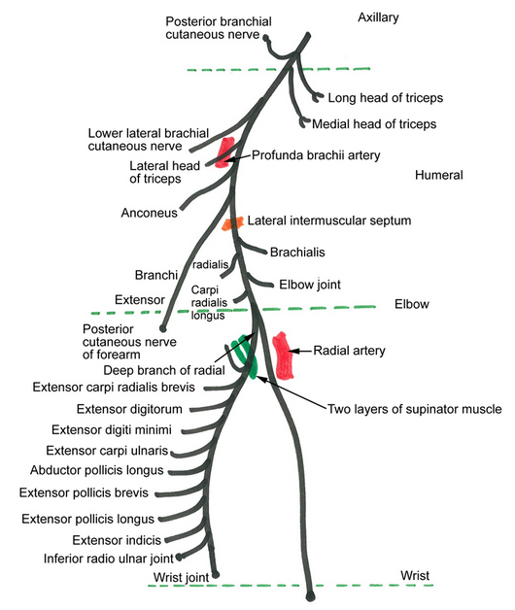

Slide 11
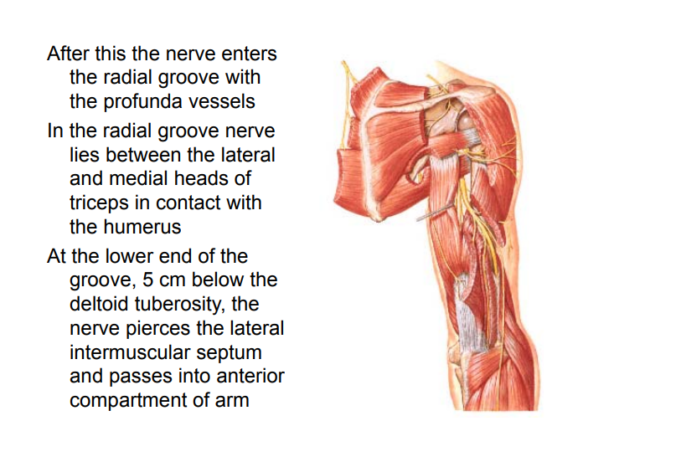

Slide 14
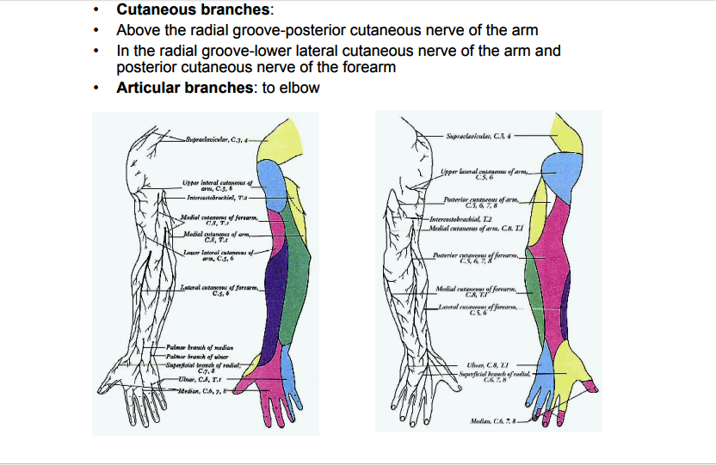

Slide 16
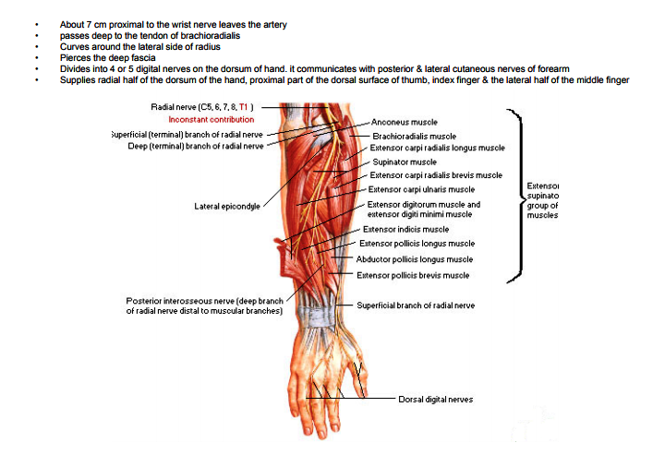

Slide 19
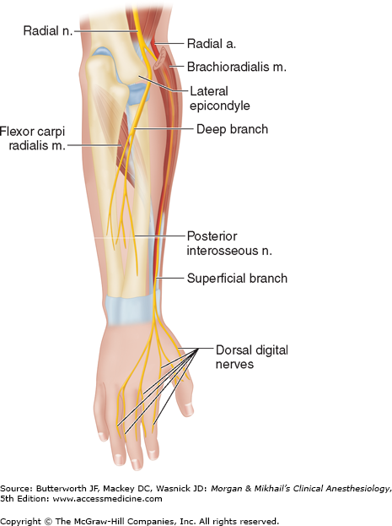

Slide 24
A lesion of the lower trunk of the brachial plexus will impair but not eliminate the function of which muscle?
A Biceps brachii
B Pectoralis major
C Supraspinatus
D Serratus anterior
Answer B

Slide 25
Injury to radial nerve in lower part of spiral groove:
a) Spares nerve supply to extensor carpi radialis longus
b) Results in paralysis of anconeus muscle
c) Leaves extensions at elbow joint intact
d) Weakens pronation movement

Slide 27
Tests for clinical examination of the radial nerve
Motor supply - triceps, brachioradialis, and the extensor muscles of the hand.
If the radial nerve is affected below the upper third of the upper arm then: -
brachioradialis and the extensor muscles are affected –
the patient will have a wrist drop which can be demonstrated by the patient's inability to extend the wrist when his elbow is flexed and his forearm pronated.
If a lesion affects the radial nerve above the upper third of the upper arm then: - function of triceps - extension of the elbow - is also affected.
Sensation - injury to the radial nerve at any level will cause loss of sensation over the anatomical snuff box.

Slide 28
Cheiralgia paraesthetica ('handcuff neuropathy' wristwatch neuropathy')
entrapment neuropathy of the radial nerve may occur at the wrist (cheiralgia paraesthetica)
radial nerve at this level provides sensation to the anterior aspect of the 1st MCPJ and the posterior lateral 3 1/2 fingers excluding the finger tips
area affected is typically on the back or side of the hand at the base of the thumb, near the anatomical snuffbox, but may extend up the back of the thumb and index finger and across the back of the hand
symptoms include numbness, tingling, burning or pain
since the nerve branch is sensory there is no motor impairment
may be distinguished from de Quervain syndrome because it is not dependent on motion of the hand or fingers

Slide 29
Causes of cheiralgia paraesthetica
Cheiralgia paraesthetica may be seen in1. prisoners with tight handcuffs 2.where there has been excessive struggling against a normal handcuff.
3.Tight watches, bands or bracelets may also cause this condition
4.other injuries or surgery in the wrist area can also lead to symptoms, including surgery for other syndromes such as de Quervain's
Exact aetiology is unknown, as it is unclear whether direct pressure by the constricting item is alone responsible, or whether oedema associated with the constriction also contributes
Management:
usually settles with conservative therapy (avoidance of compression) but may take up to 2 months
complete anaesthesia suggests complete severance of the radial nerve and should prompt urgent surgical referral.

Slide 30
Wartenberg syndrome
Wartenberg syndrome
pain over the distal radial forearm associated with paresthesias over the dorsal radial hand.
They frequently report symptom magnification with wrist movement or with tight pinching of the thumb and index digit.
These individuals demonstrate a positive Tinel sign over the radial sensory nerve and local tenderness. Hyperpronation of the forearm can cause a positive Tinel sign. A high percentage of these patients reveal physical examination findings consistent with de Quervain tenosynovitis.

Slide 31
Posterior interosseous nerve syndrome
weakness or paralysis of the wrist and digital extensors. Pain may be present, but it usually is not a primary symptom. Attempts at active wrist extension often result in weak dorsoradial deviation as a consequence of preservation of the radial wrist extensors but involvement of the extensor carpi ulnaris and extensor digitorum communis.
These patients do not have a sensory deficit.
Rarely, compression of the posterior interosseous nerve may occur after bifurcation into medial and lateral branches.

Slide 32
Posterior interosseous nerve syndrome-cont..
Selective medial branch involvement causes
paralysis of the extensor carpi ulnaris, extensor
digiti quinti, and extensor digitorum communis.
With compression of the lateral branch, paralysis of the abductor pollicis longus, extensor pollicis brevis, extensor pollicis longus, and extensor indicis proprius is noted.

Slide 33
All of the following nerves arise from the posterior cord of the brachial plexus except-
A Long thoracic
B Thoracodorsal
C Axillary
D Upper subscapular
E Radial

Slide 34
Radial nerve palsy
Radial nerve palsy in the middle third of the arm is characterized by palsy or paralysis of all extensors of the wrist and digits, as well as the forearm supinators. Very proximal lesions also may affect the triceps. Numbness occurs on the dorsoradial aspect of the hand and the dorsal aspect of the radial three-and-a-half digits. Sensation over the distal and lateral forearm is supplied by the lateral antebrachial cutaneous nerve and therefore is preserved

Slide 35
Radial tunnel syndrome
pain over the anterolateral proximal forearm in the region of the radial neck.
appears in individuals with work requiring repetitive elbow extension or forearm rotation. The maximum tenderness is located four fingerbreadths distal to the lateral epicondyle. (By way of comparison, with lateral epicondylitis, maximum tenderness is usually directly over the epicondyle.)
Symptoms are intensified by extending the elbow and pronating the forearm. In addition, resisted active supination and extension of the long finger cause pain. Weakness and numbness usually are not demonstrated.

Slide 36
In de Quervain disease, injection of cortisone and lidocaine into the tendon sheath of the extensor pollicis brevis and the abductor pollicis longus relieves the symptoms immediately and sometimes permanently. An injection of cortisone and lidocaine into the area of compression of the superficial radial nerve causes the symptoms to subside; however, numbness in the nerve distribution follows, and when the injection wears off, the symptoms return.
A Tinel sign is present in patients with Wartenberg syndrome but usually not in those with de Quervain disease. The two conditions may be related. The inflammation from de Quervain disease causes an inflammation of the nerve. With resolution of one condition, the other may subside or may be adequately treated with an injection.

Slide 40
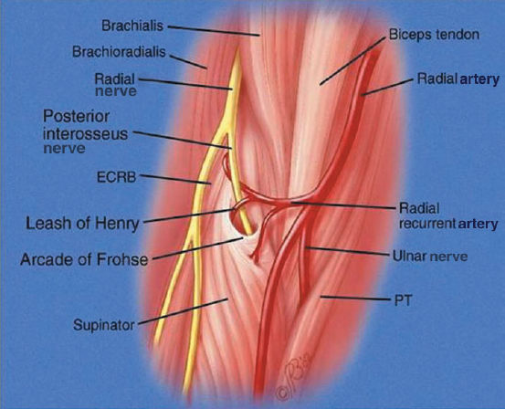

Slide 42
Regarding the radial nerve which statement is incorrect?
a) It passes anterior to the lateral epicondyle of the humerus
b) Injury to the radial nerve from fracture of the shaft of the humerus will result in wrist drop
c) Injury to the deep radial nerve in the mid forearm will prevent extension only at the MCPJs
d) Sensory loss from injury to the superficial radial nerve will usually result in loss of sensation over the entire thumb
e) It is the larger terminal branch of the posterior cord of the brachial plexus

Slide 43
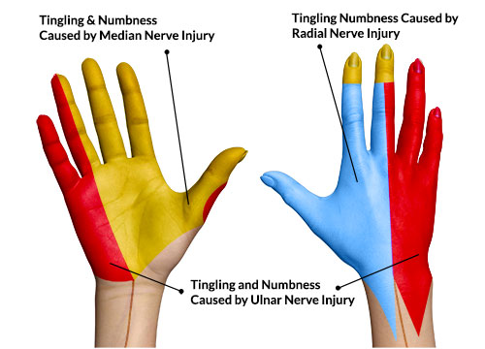

Slide 44
If there is a sensory loss over a variable area on the dorsum of the hand and proximal part of dorsal surface of the lateral 3 ½ fingers, the nerve damaged is-
A Deep branch of radial
B Superficial branch of radial
C Lateral cutaneous nerve of forearm
D Dorsal cutaneous branch of ulnar nerve
E Palmar cutaneous branch of median nerve
Answer B

Slide 45
The radial nerve gives off the following muscular branches in the arm except to-
A Long head of triceps
B Brachialis
C Lateral head of triceps
D Anconeus
E Brachioradialis
Answer B

